Slide 1
SWG2: Astrochemistry & the molecular emergence of life
Science Use Case Slides January 2023

Slide 2
Observing the Effects of Chemistry on Exoplanets and Planet Formation
McGuire, Bergin, Blake, Burkhardt, Cleeves, Loomis, Remijan, Shingledecker, Willis
Astrochemical models are needed to predict full compositions of gas and ice in pp disks based on detectable simple gas species
In earlier stages of star formation, larger molecular inventories can be observed, providing an opportunity to tune our models
Line confusion limit has already been reached for ALMA, but there is significant discovery space left at cm wavelengths
Detecting new molecules and characterizing physical-chemical evolution in early star forming stages will anchor astrochemistry models
Requires: High sensitivity, high spatial resolution

Slide 3
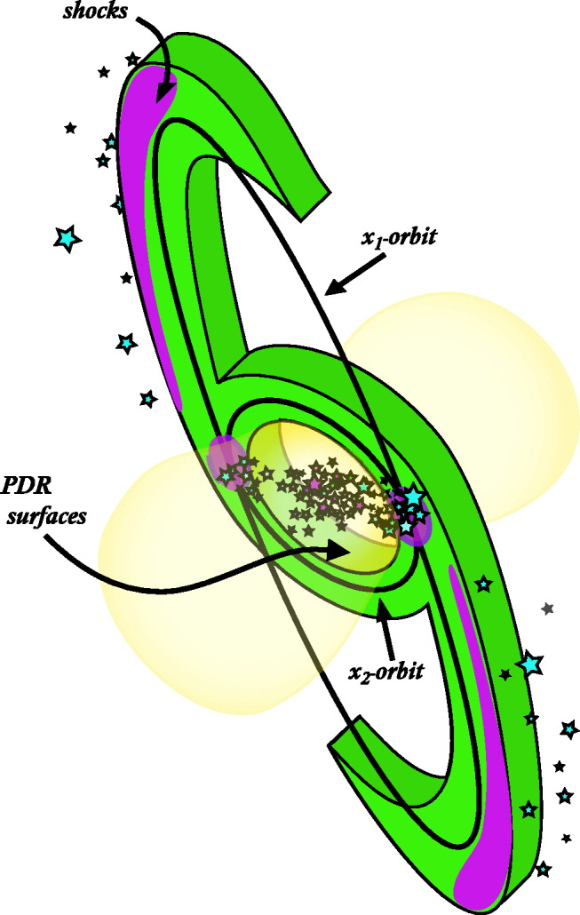
Extragalactic Astrochemistry
Gorski
The chemical evolution of the ISM can be traced along the X1-X2 orbits of galaxies and an opportunity to tune star formation driven chemical evolution (e.g., Meier & Turner 2005, Harada+2019)
We can clarify how galaxies evolve via constraints on the physical conditions, cosmic ray ionization rates, nuclear activity diagnostics (e.g., shocks, mechanical heating, outflow chemistry, etc.; Aalto+2015, Izumi+2016, Viti+2014, Garcia-Burillo+2017, Harada+2021)
Meier & Turner 2005
Harada+2019

Slide 4
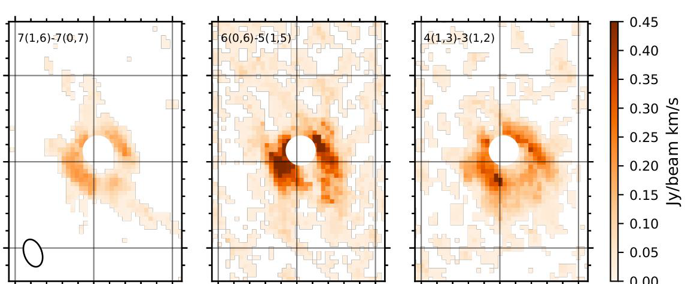
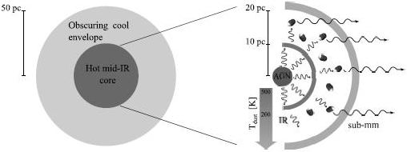
Extragalactic Astrochemistry
Gorski
Methanimine (CH2NH)
The early stages of AGN evolution is obscured by extreme columensities (e.g., Barcos-Muños+2015, Martìn+2016, Falstad+2021) and frequencies above 80 GHz are opaque. The cm wavelength regime is more transparent, thus there exists significant opportunity for discovery.
Nuclear regions of galaxies show evidence for biologically relevant chemistry and the most massive environment to test chemical evolution models (Gorski+2022).
Gorski+2022
Aalto+2015

