Slide 1
A next-generation Very Large Array (ngVLA)
Eric J. Murphy – ngVLA Project Scientist
ngVLA.nrao.edu

Slide 2
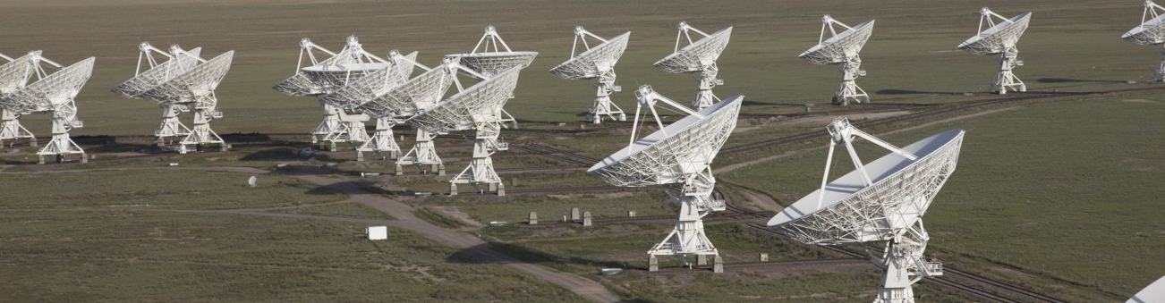
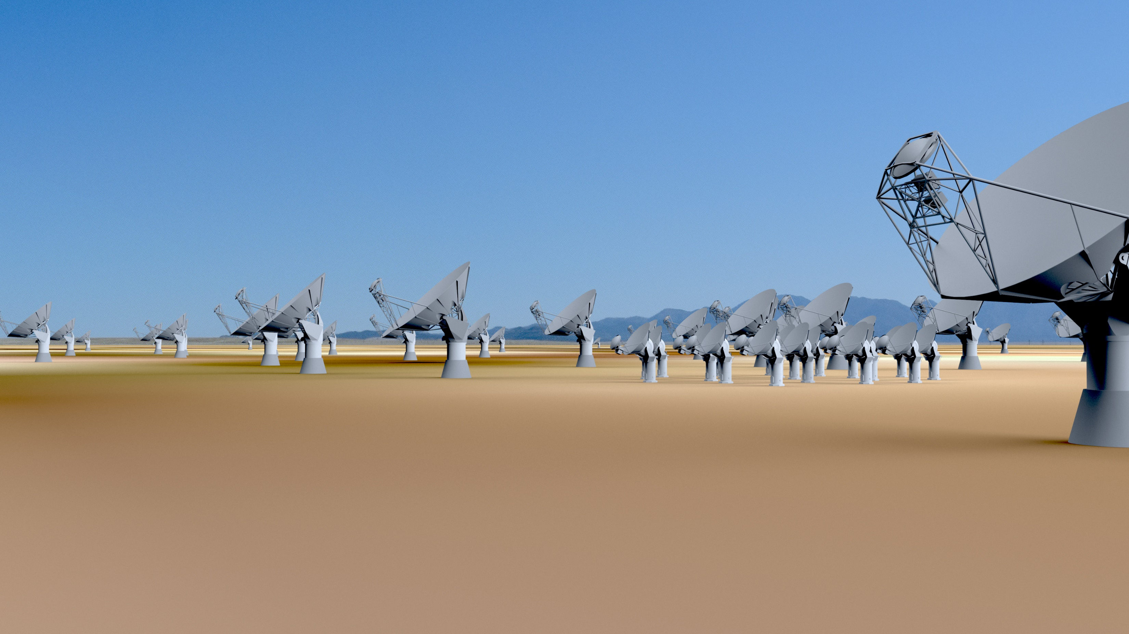
The next generation Very Large Array
The Jansky Very Large Array
2016 – Project Office Established
2020 – Astro 2020 report
2021 – Enter as NSF-MREFC Candidate
2024 – Construction Begins
2028 – Early Science
2034 – Full Science Operations
1972 – Approved by Congress
1975 – First Antenna in place
1980 – Full science operations
2001 – Complete electronics upgrade approved by NSF
2011 – Jansky VLA full science ops
Notes:
~7200 refereed papers with ~300,000 citations
~500 PhD theses
The VLA has been among the most productive telescopes ever!
Major recent science:
FRB localization of completely unknown phenomena
distance record for atomic H in emission
Investigations of solar weather.
Narrowing models for NS-NS merger GW170817

Slide 3
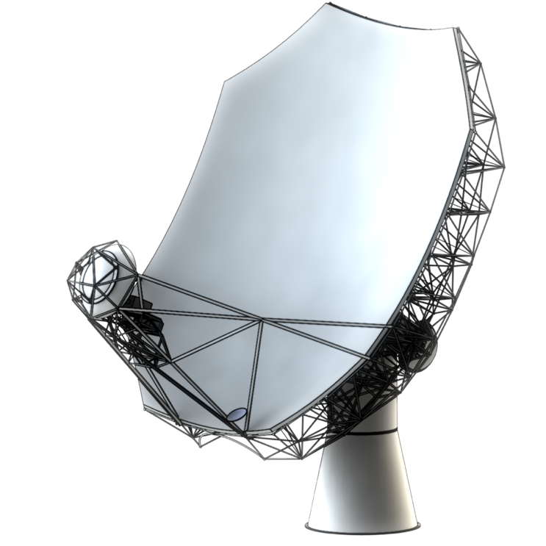
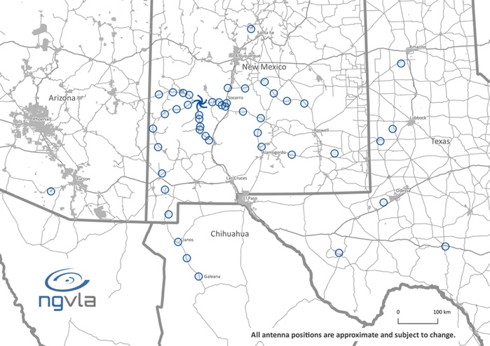
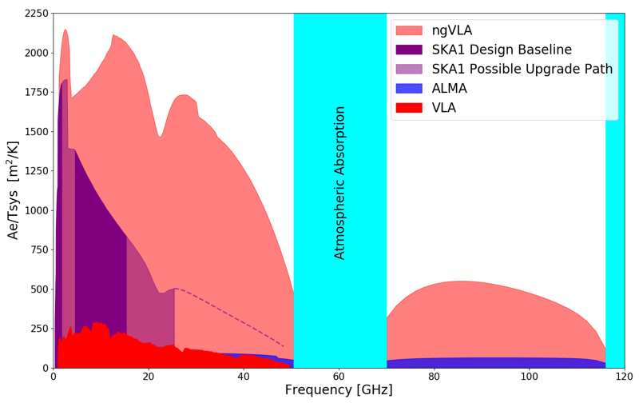
A next-generation
Very Large Array (ngVLA)
Scientific Frontier: Thermal imaging at milli-arcsec resolution
Sensitivity/Resolution Goal: 10x sensitivity & resolution of JVLA/ALMA
Frequency range: 1.2 –116 GHz
Located in Southwest U.S. (NM, TX, AZ) & MX, centered on VLA
Low technical risk (reasonable step beyond state of the art)
550 km
Bridging ALMA/SKA Scientifically
Complementary suite of meter-to-submm arrays for the mid-21st century
< 0.3 cm: ALMA 2030
0.3 to 3 cm: ngVLA
> 3 cm: SKA
http://ngvla.nrao.edu
Notes:
MAIN GOAL OF ARRAY
To be flexible enough to support the breadth of scientific investigations that will be proposed by its creative scientist-users over the decades-long lifetime of the instrument.

Slide 4
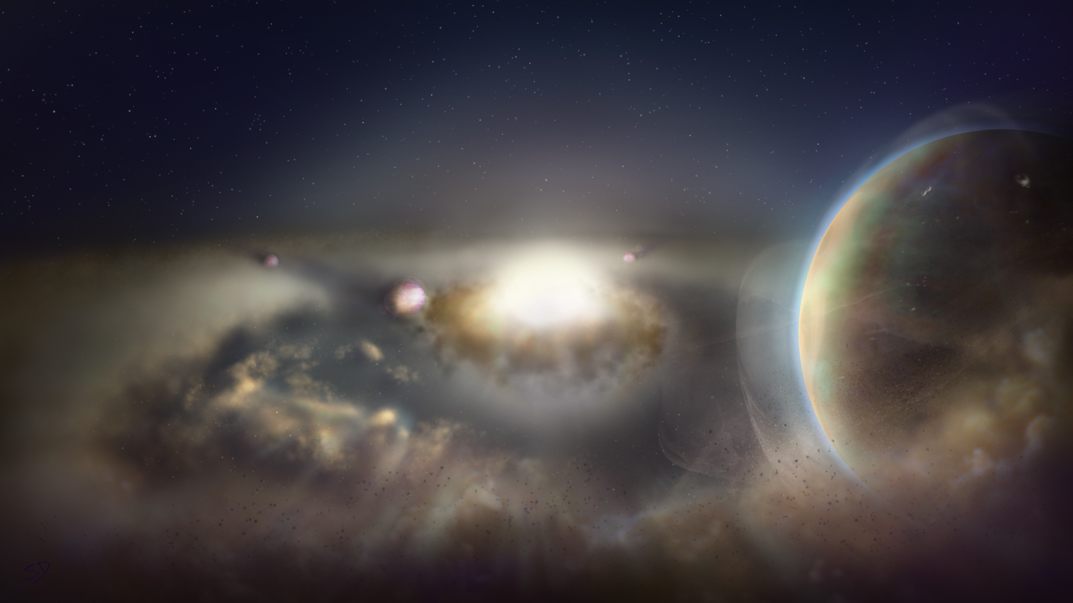
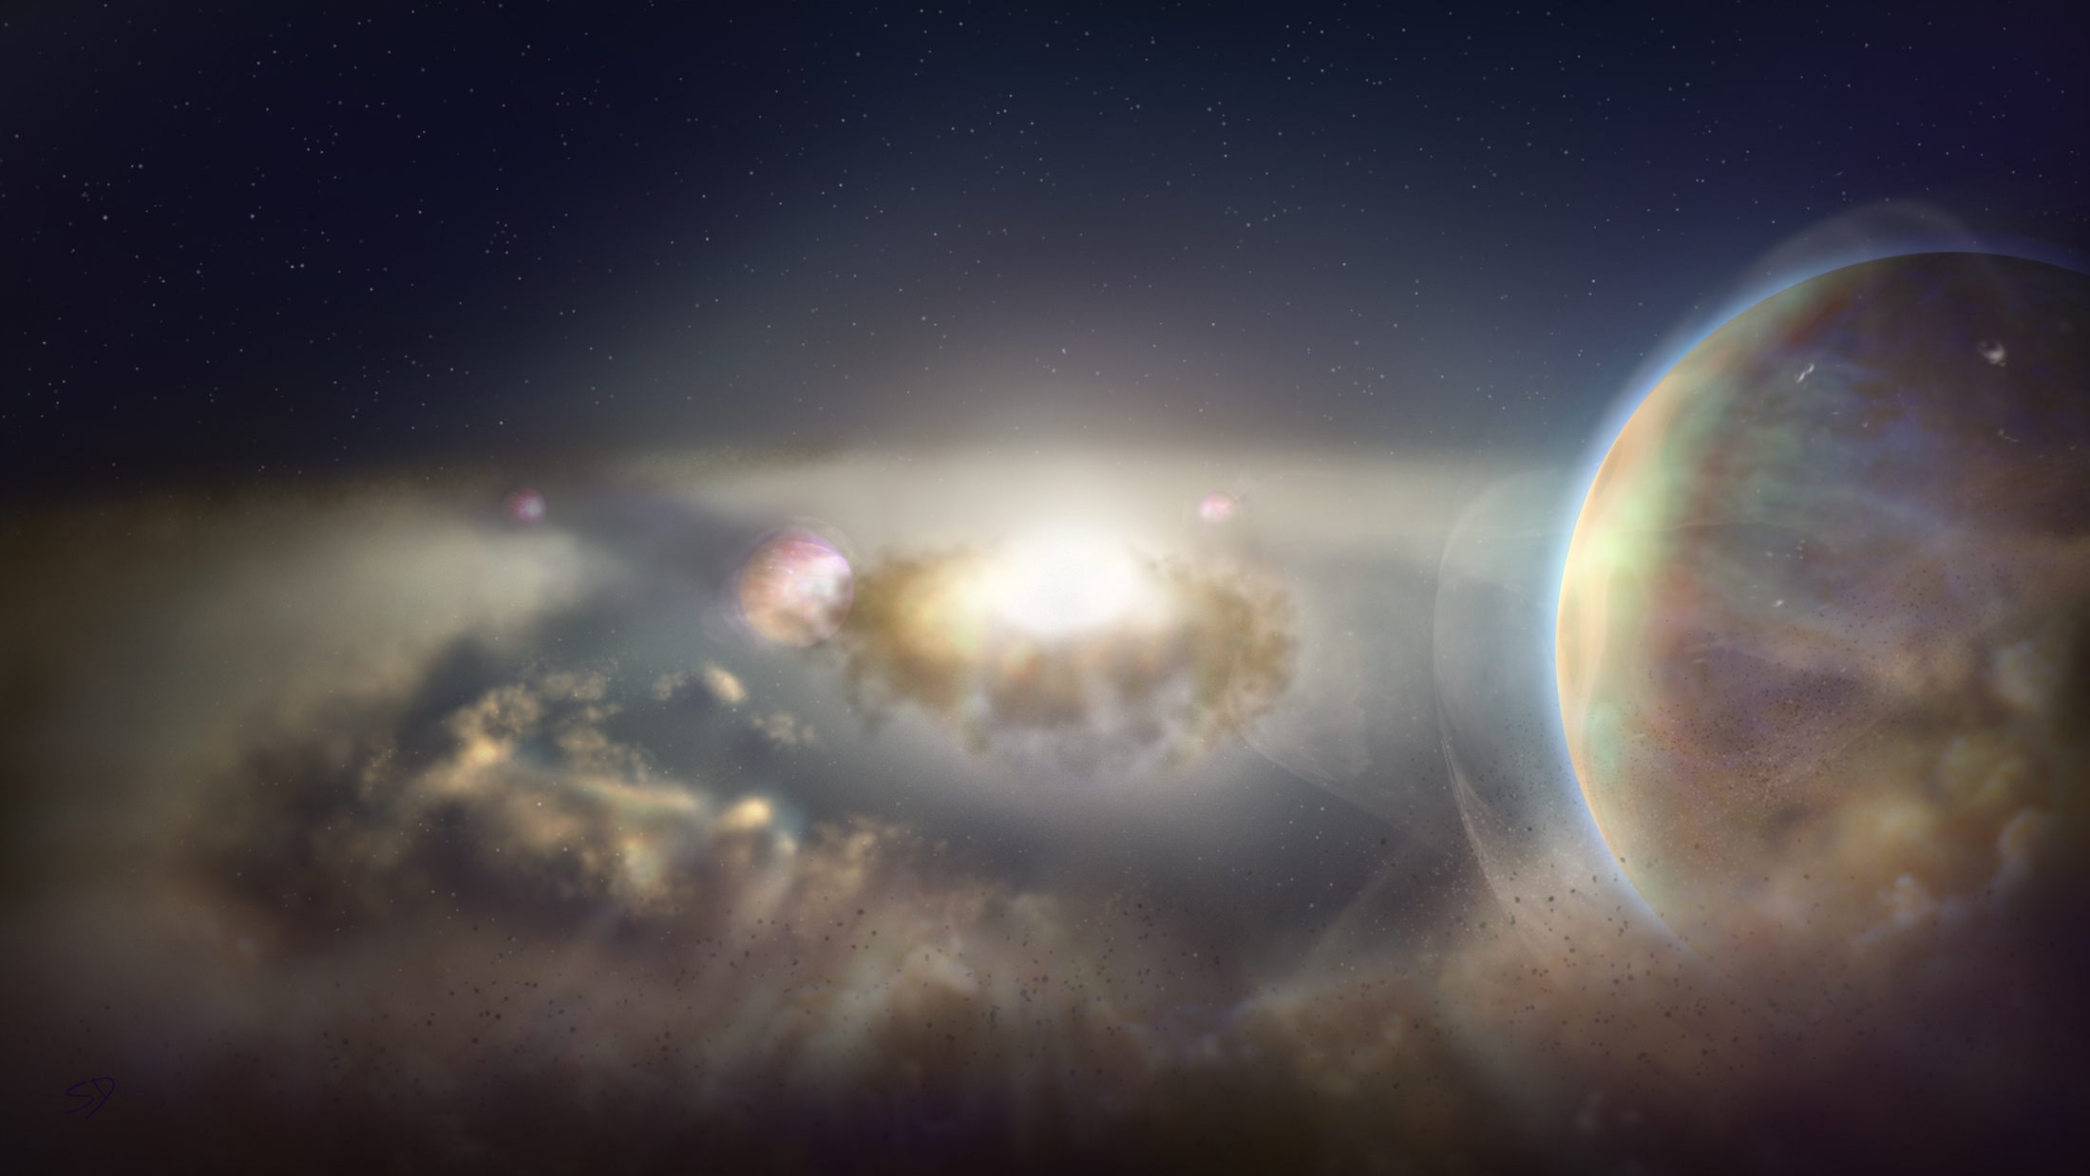
ngVLA Key Science Goals
(ngVLA memo #19)
Unveiling the Formation of Solar System Analogues on Terrestrial Scales
Probing the Initial Conditions for Planetary Systems and Life with Astrochemistry
Charting the Assembly, Structure, and Evolution of Galaxies Over Cosmic Time
Using Pulsars in the Galactic Center as Fundamental Tests of Gravity
Understanding the Formation and Evolution of Stellar and Supermassive
BH’s in the Era of Multi-Messenger Astronomy
ngvla.nrao.edu
Notes:
Main Goal of Array is to be FLEXIBLE to achieve each of these science goals.

Slide 5
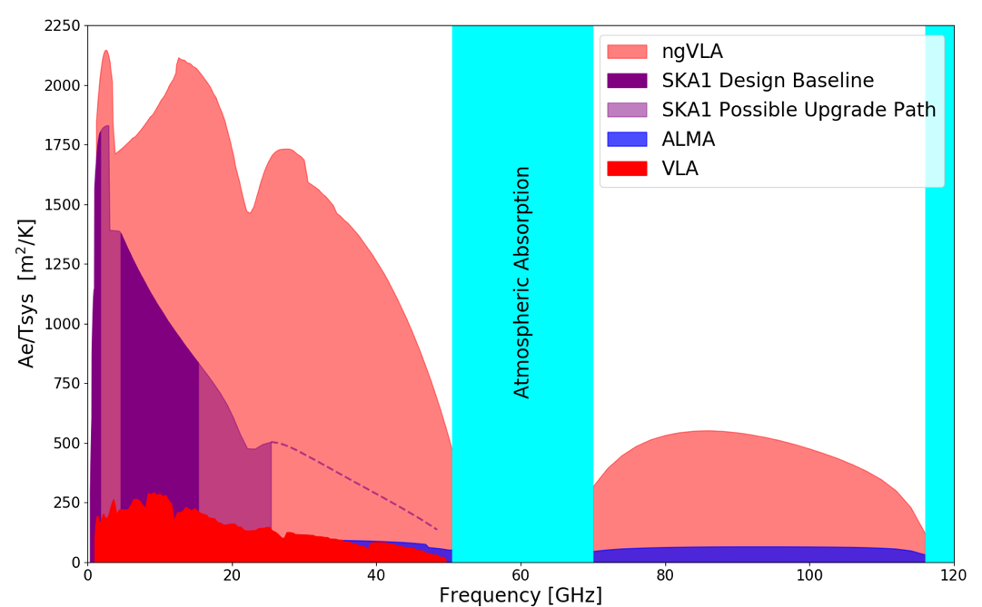
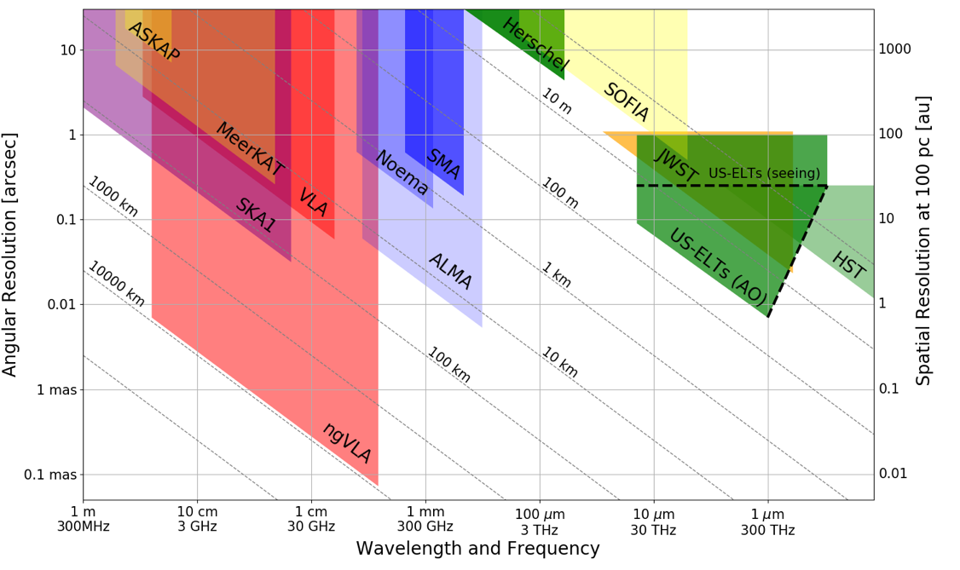
Bridging SKA & ALMA Scientifically
Thermal Imaging on mas Scales at λ ~ 0.3cm to 3cm
Terrestrial zone planet formation: 1AU @ 140pc
Complementary suite from cm to submm arrays for the mid-21st century
< 0.3cm: ALMA 2030 superb for chemistry, dust, fine structure lines
  0.3 to 3cm: ngVLA superb for terrestrial planet formation, dense gas history, baryon cycling
  > 3cm: SKA superb for pulsars, reionization, HI + continuum surveys
Notes:
Snapshot comparison of effective collecting area for dish-arrays expected in the 2030’s.
Assumes SKA deployment baseline (July 2017)
SKA 1
- 130 antennas, SKA bands 1, 2
- 67 antennas, SKA Band 5 a/b
MeerKAT:
- 64 antennas, bands 1, 2, 3
MeerKAT has receiver indexer with 4 slots

Slide 6
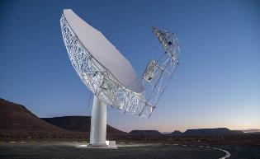
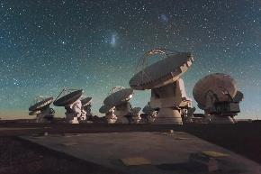
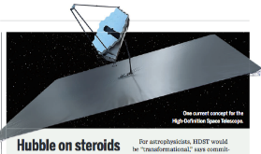
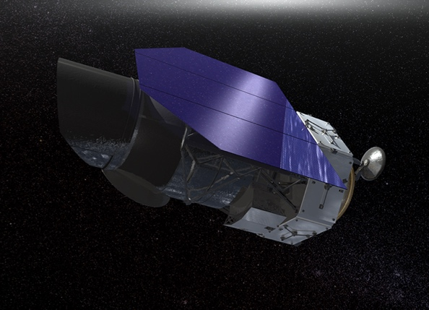
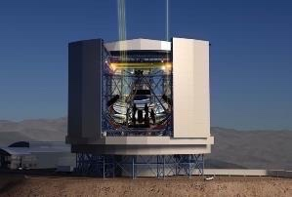
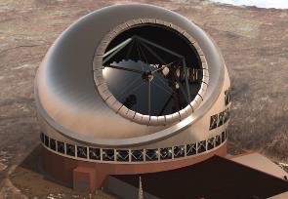
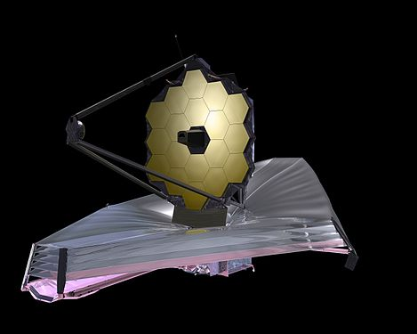
Highly Synergistic with Other Facilities on Similar Timescales
SKA/Lynx
  Atomic/non-thermal
  Molecular/thermal
ALMA
  Warm/star-forming
  Cold/dense fuel for SF
LUVOIR/HabEx
  Image earth-like planets
  Image terrestrial-zone planets forming
OST (FIR surveyor)
  C/WNM & WIM
  Cold Molecular Medium
TMT/GMT
  Stellar Mass and Unobscured SF
  Dense Gas and Obscured SF
JWST/WFIRST
  Continuing its legacy in many areas of astrophysics
Notes:
No matter which of these facilities materialize, their user-base will be ngVLA users as well.

Slide 7
ngVLA Project
Project Office leadership team:
  Project Director: Mark McKinnon
  Project Manager: Chris Langley
  Project Scientist: Eric Murphy
  Project Engineer: Rob Selina
  Cost Analyst: Alexia Nalewaik
  System Engineer: Thomas Kusel
10 Integrated Product Teams (IPTs).
MREFC-style project definition.
Actively engaged science and technical advisory councils.

Slide 8
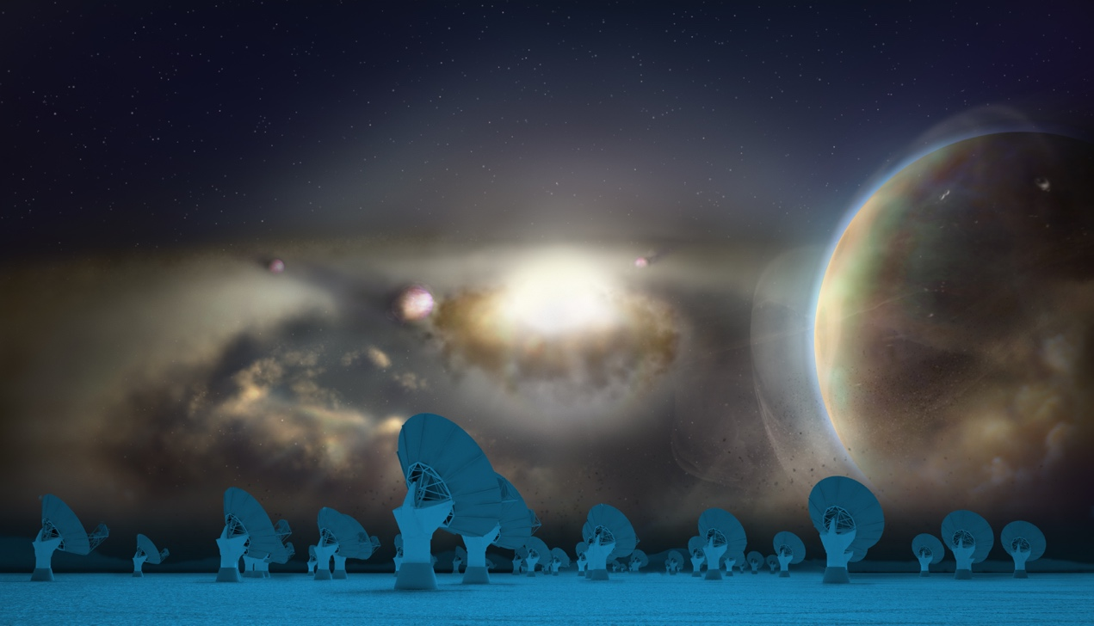







ngVLA
Science Advisory Council
Interface between the Community & NRAO -- Est. Sept 2016
Recent/Current Activities:
  Lead SWGs: science use cases → telescope requirements
  SOC for science meeting in June 2017/2018/2019
  Lead Science case development → ‘Science Book’ & Astro2020 White Papers
  Document Review: e.g., Sci Reqs, Ops Con, Ref Observing Program, etc.
  Help with preparation of Astro2020 APC white papers
International Participation
Executive Committee
Alberto Bolatto (Maryland: co-Chair)
Andrea Isella (Rice: co-Chair)
Brenda Matthews (NRC–Vic: SWG1 Chair)
Danny Dale (Wyoming: SWG2 Chair)
Dominik Riechers (Cornell: SWG3 Chair)
Joseph Lazio (JPL: SWG4 Chair)
Shri Kulkarni (Caltech)
James Di Francesco (NRC–Vic)
Notes:
Established Sept 2016, immediately after opening of project office

Slide 9














































Strong Community Participation

Slide 10
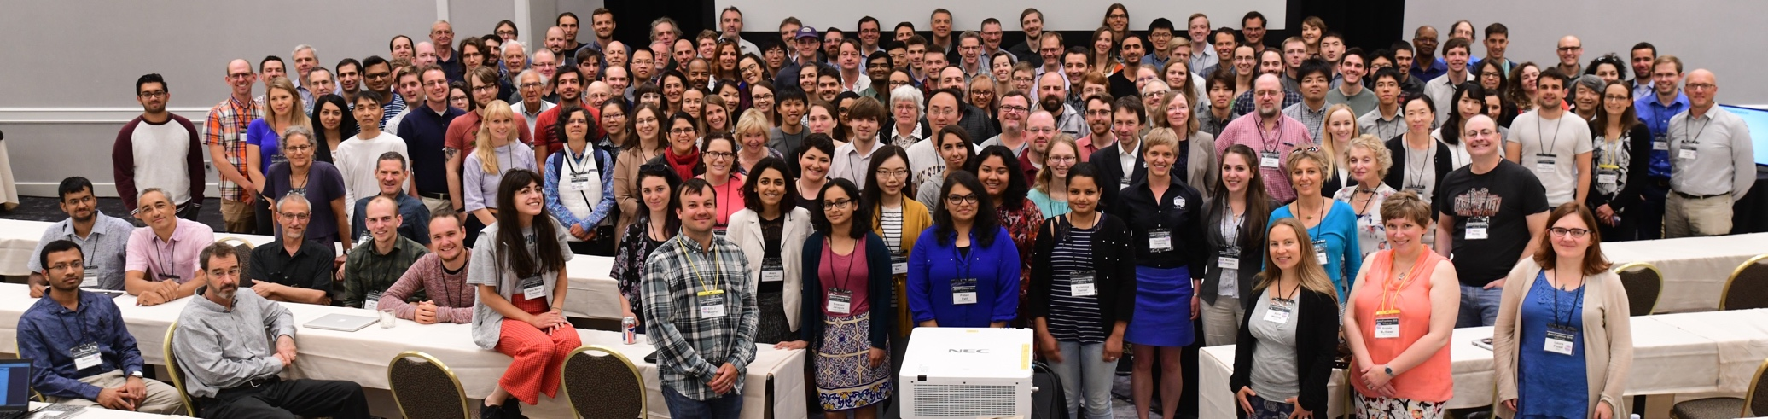
2018 Science Meeting
Meeting was science-focused and wavelength agnostic
  Brought together a broad cross—section of community
3 Parallel Sessions:
  Origins of Exoplanets and Protoplanetary Disks
  Mechanisms of Galaxy Evolution
  Black Holes and Transient Phenomena
200+ registrants and 70+ students! - We are creating our next-generation of users
Notes:
With 200+ registrants, including 70+ students, the meeting showcased strong community support from current and next-generation users to pursue cutting-edge space and ground-based facilities to tackle the most pressing questions in astrophysics, with a special emphasis on the ngVLA.

Slide 11
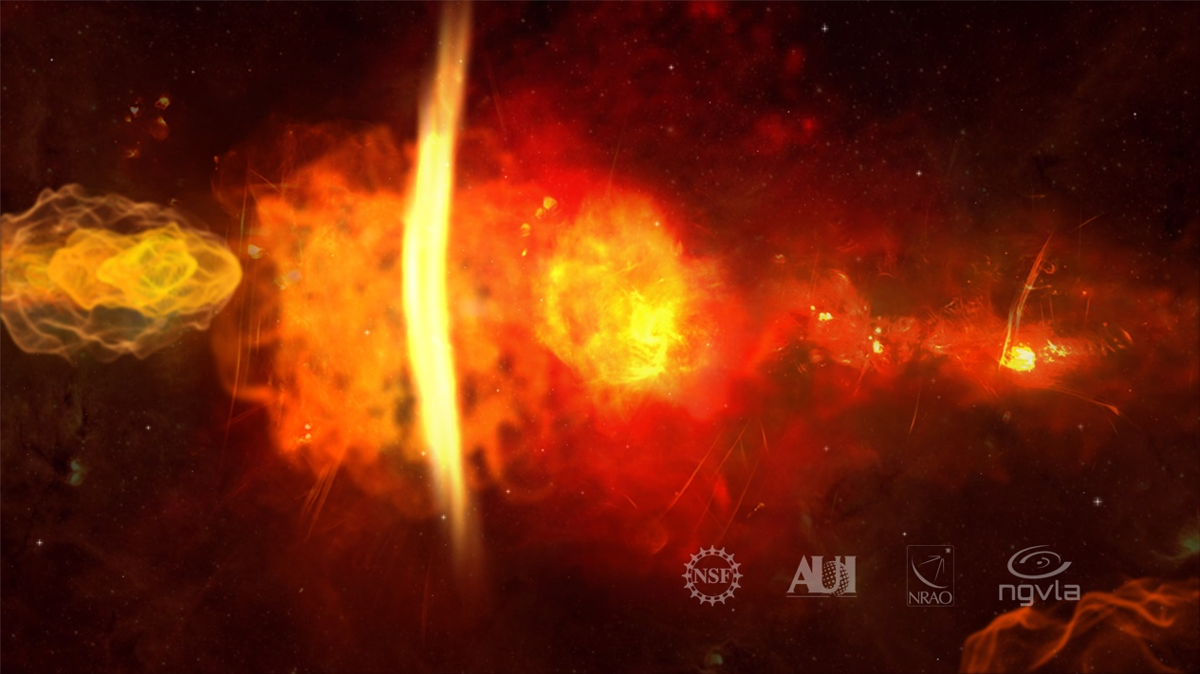
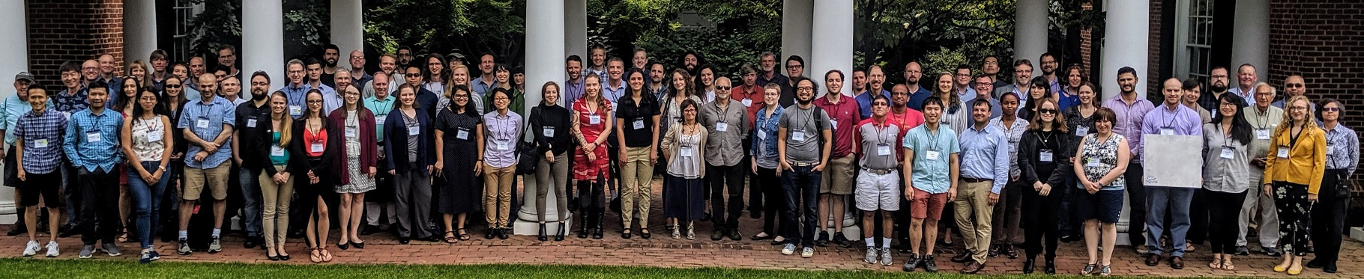
2019 Science Meeting: Radio/mm Astrophysical Frontiers in the Next Decade
25-27 June, 2019 in Charlottesville: http://go.nrao.edu/ngVLA19
Focus on compelling Astro2020 Science WPs requiring cm/mm observations.
Early Career participation strongly encouraged
  Housing covered for presenting students
Notes:
Went out to the community and asked them to investigate if there was a major science case for such a facility…
Major community effort.
Trying to keep it in a single volume of reasonable weight – can’t afford any lawsuits.

Slide 12
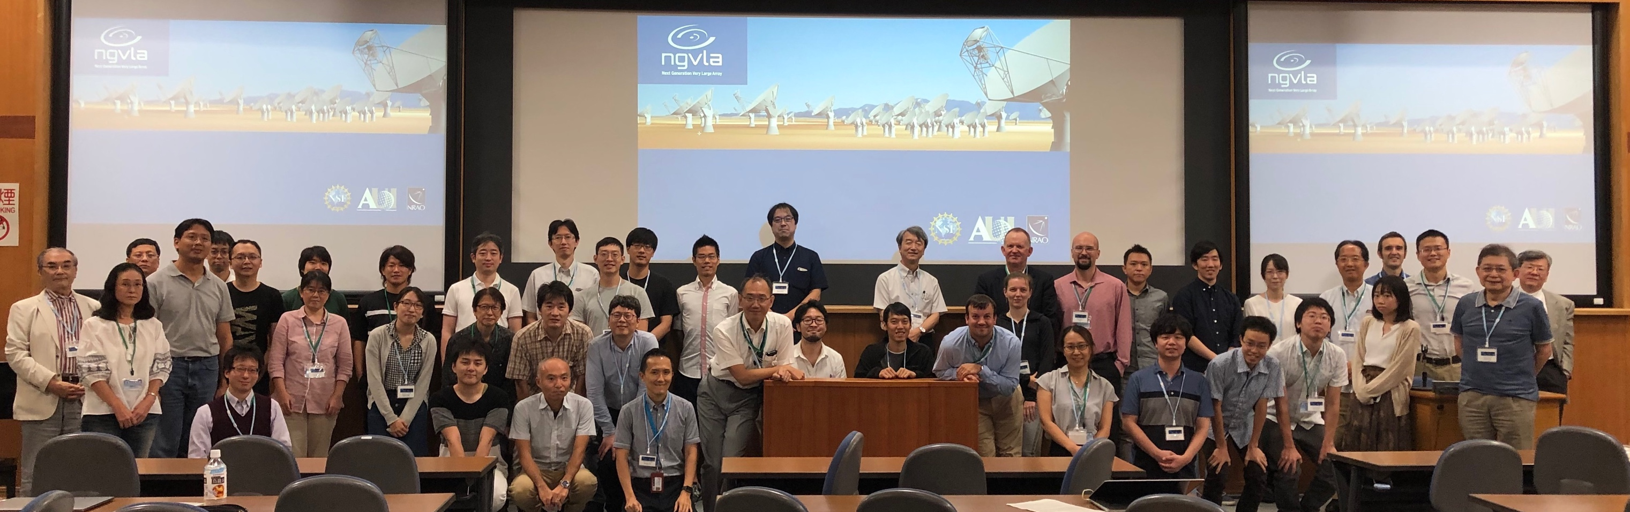
First Internationally-Led Science Meeting!
Broad Participation Largely Dominated by Early Career Astronomers
NAOJ-ngVLA Science Meeting: September 16-20, 2019 in Mitaka, Japan
~100 Participants!
Forward looking talks covering broad scientific interests.

Slide 13

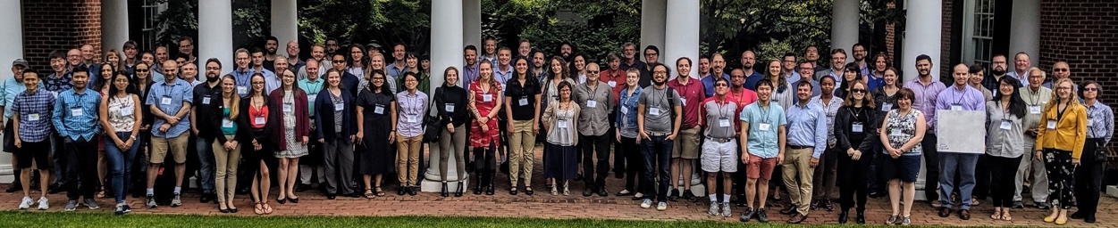
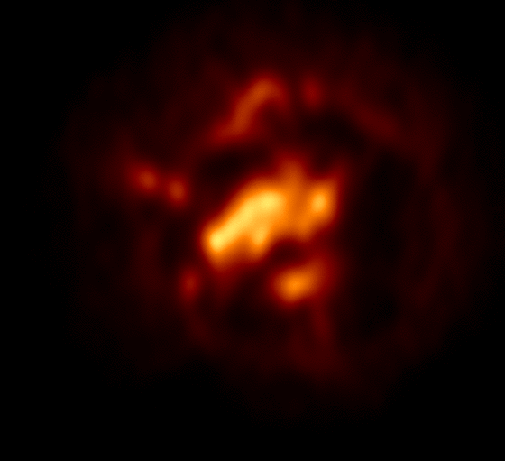


Successful Community Engagement Activities
Broad Participation Largely Dominated by Early Career Astronomers
http://go.nrao.edu/ngVLA18
Science Meetings
Short Talk Series
Community Studies
ngVLA Town Hall
http://go.nrao.edu/ngVLA19
Notes:
AGILITY!
Compact Objects: Over 850 individuals, predominantly graduate students, registered (see chart). Almost 650 individuals representing 40+ countries attended one or both days. Talks posted online, with nearly 300 views already.
Short Talk Series: A total of 768 individuals from 47 countries attended one or more presentations. The average attendance at each meeting included over 200 participants, ranging between 150-380, and represented well over 100 institutions. A large percentage of participants were graduate students. Talks posted online, with nearly 1400 views already!
2018 – Broad, multi-topic conference with parallel sessions
2019 – more ngVLA-specific workshop with talks focused on Astro2020 science and ngVLA capabilities.
Both meetings at capacity (~200 and ~120).
Approximately 1/3 of attendees were students at both meetings

Slide 14
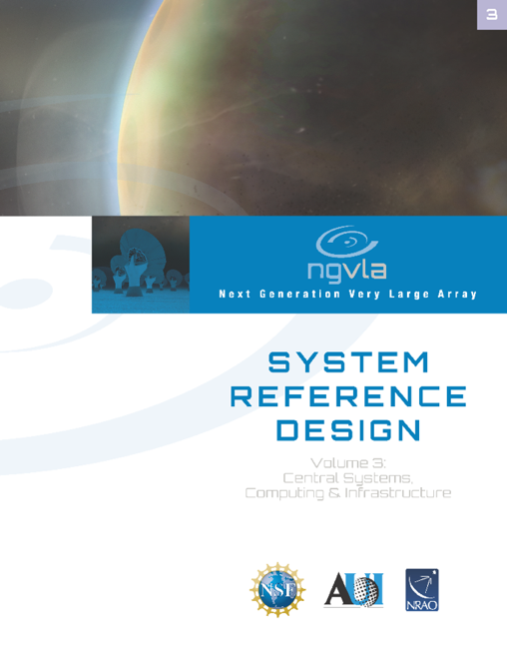
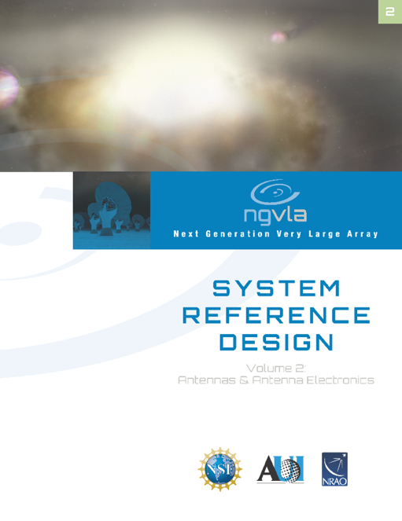
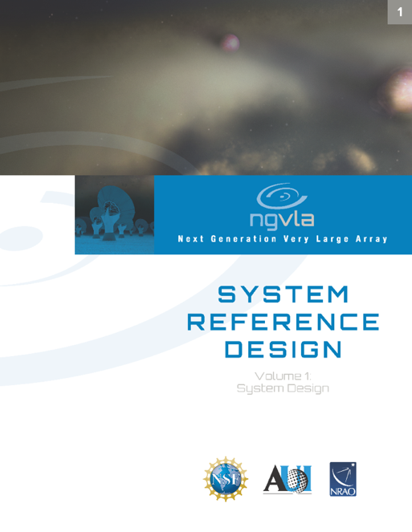
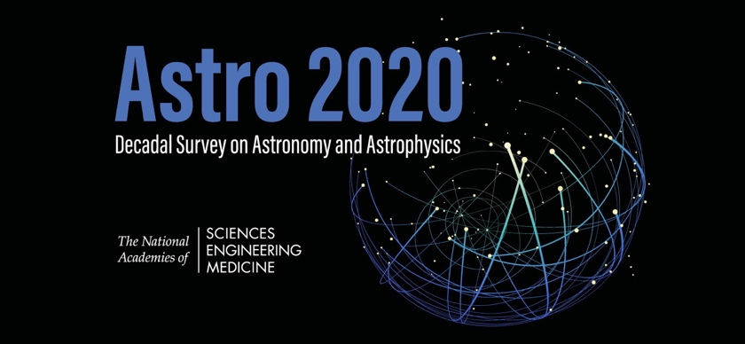
Science and Technical Documentation
ngVLA Science Book published (Dec 2018)
Facilitated community submission of ngVLA science white papers to Astro2020 Decadal Survey (Jan 2019)
  15% specifically mentioning ngVLA
Submitted ngVLA facilities (APC) white paper to Astro2020 Decadal Survey (Jul 2019)
ngVLA Reference Design Concept completed (Aug 2019)
  https://ngvla.nrao.edu/page/refdesign
Presented to Astro2020 RMS Panel (Dec. 2019)
Submitted (120 pg) Response to Astro2020 Decadal Survey RFI (Nov. 2019) + Second Response (Mar. 2020)
https://ngvla.nrao.edu/page/projdoc
Notes:
Completed Independent Cost Review (Oct 2019)
Science Book published by ASP in Dec 2018
88 peer-reviewed contributions
286 unique authors (c.f. 245 in LSST Science Book)

Slide 15
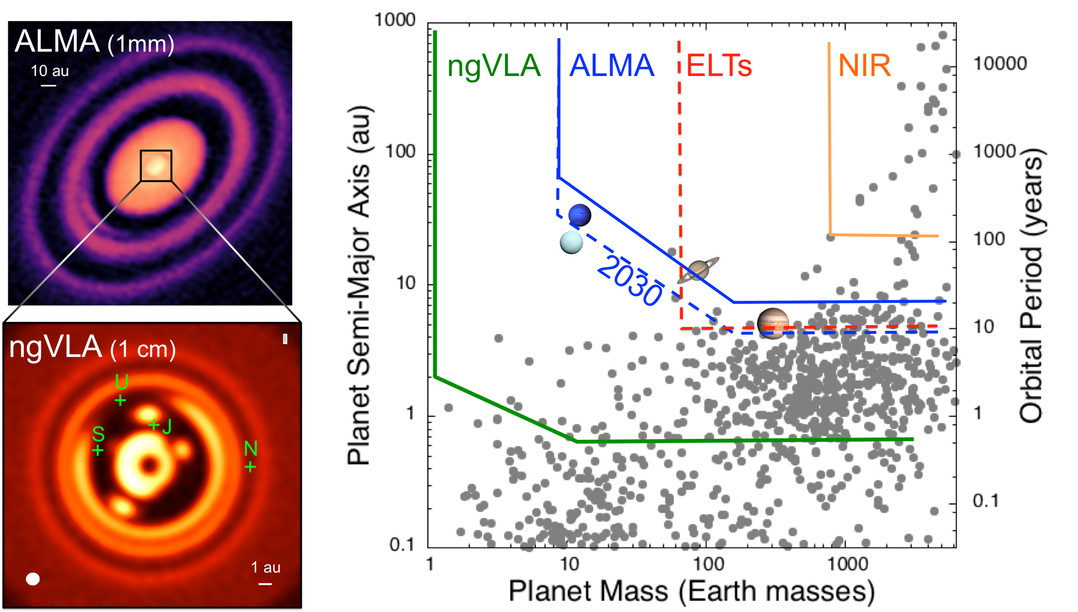
KSG1: Unveiling the Formation of Solar System Analogues
The ngVLA will measure the planet IMF down to ~5-10 Earth masses and unveil the formation of planetary systems similar to our own Solar System.
ALMA observation of HD163296 at 1mm along with a simulated 1 cm ngVLA observations (Ricci et al. 2019) of the innermost 24 au region at 1 au resolution for Jupiter-, Saturn-, and Neptune-like planets.
The distribution of exoplanets and young planets embedded in circumstellar disks: Then ngVLA will discover many hundreds of planets with orbital periods <10 Myr.

Slide 16
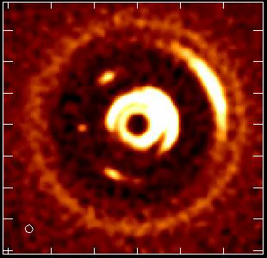
KSG1: Unveiling the Formation of Solar System Analogues
The ngVLA will measure the orbital motion of planets and related features on monthly timescales.
The ngVLA will measure the planet IMF down to ~5-10 Earth masses and unveil the formation of planetary systems similar to our own Solar System.
Simulated 100 GHz ngVLA observations of a newborn planetary system comprising a Jupiter analogue orbiting at 5 AU from a Solar type star.
Ricci et al. (2018)
Notes:
Turning planet formation science into a time-domain science!
Of the 3 blobs you see at 5 au, the one associated to the Jupiter-mass planet is the one in the middle.
The other two blobs in the movie (leading and trailing) are dust particles concentrated in the L4 and L5 Lagrangian points of the star - Jupiter-mass planet system.
Dust emission comes from the circum-planetary disk orbiting the planet, so the planet is mostly formed in that movie (I say "mostly" cause material in the circumplanetary disk will accrete onto the planet, therefore increasing its mass by some amount).

Slide 17
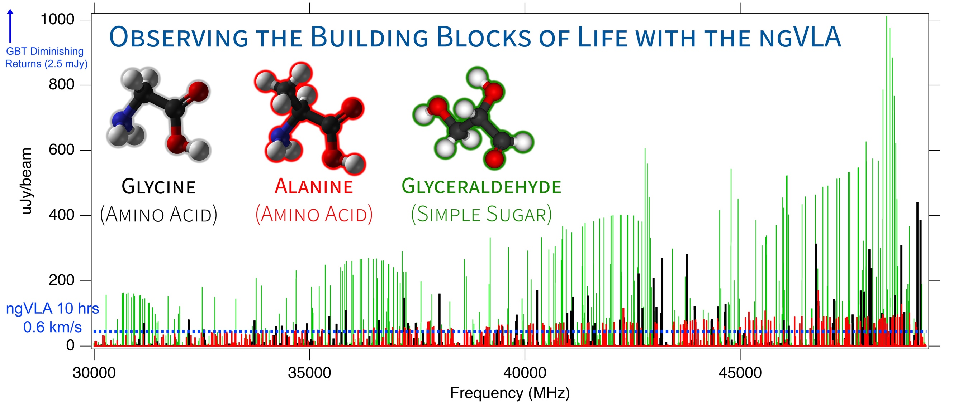
KSG2: Probing the Initial Conditions for Planetary Systems and Life with Astrochemistry
  The ngVLA can detect complex pre-biotic molecules and provide the chemical initial conditions in forming solar systems and individual planets
Credit: Brett McGuire (NRAO)
Notes:
This is a simulation of ~3 complex organic molecules, not currently detected in the ISM, but which are good candidates for detection.
The simulation assumes that the emission is coming from a compact, 1" hot core in Sgr B2(N), from molecules with column densities of 10^12 - 10^14 cm-2, at T = 200 K, and with a linewidth of 3 km/s.
The simulation does *not* contain any currently-detected species, meaning that a real spectrum in this frequency range would have many, many bright lines off the scale of this graph.
The red horizontal line is the ~rms of the current GBT PRIMOS observations. These suffer greatly from beam dilution, as the 1" source is diluted in a 30" GBT beam. This rms is about what we can reasonably get with reasonable integration times at the GBT. Drilling deeper will take far longer than is feasible for a survey.
The green line is taken from the ngVLA tech specs page for line sensitivity at 10 km/s in 1 hr, degraded for 0.3 km/s channels.
The blue shaded region is the area in which I project, from a statistical analysis of the PRIMOS observations, we will hit line-confusion in this frequency range. There is little point in integrating more than 3 sigma deeper than this.
So what are the take-away messages here?
1) the ngVLA will almost certainly provide access to a wealth of new molecular detections of molecules similar to the representative species shown here
2) the ngVLA in reasonable integration times (say 4-20 hours) should hit line confusion in this most molecularly-rich galactic source at the 3 sigma level, something that the GBT and (J/E)VLA cannot hope to accomplish.

Slide 18
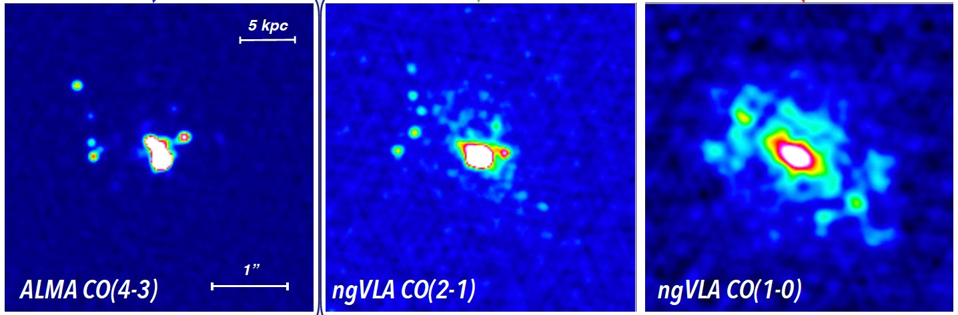
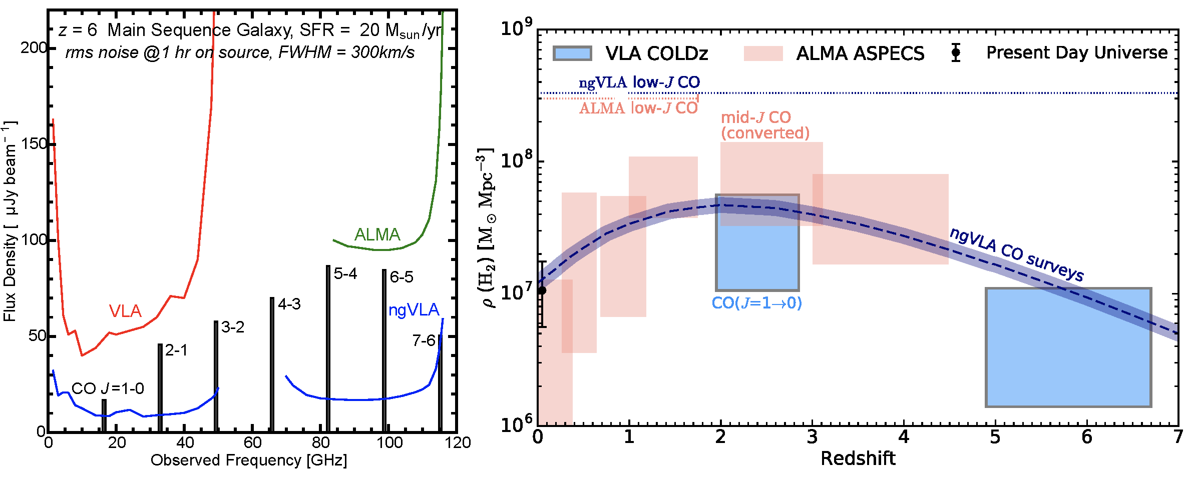
KSG3: Charting the Assembly, Structure, and Evolution of Galaxies from the First Billions Years to the Present
𝜃 ≈ 0.3”
𝜃 ≈ 0.3”
𝜃 ≈ 0.5”
SMG at z = 4.4; SFR ≈ 400 M⨀ /yr
Total molecular gas content largely missed by high-J lines
Credit: Caitlin Casey (UT Austin)
The ngVLA will routinely detect molecular gas in “normal” galaxies at z=6 via low-J transitions that remain inaccessible to ALMA.
The ngVLA will provide >10x improvement in our knowledge of the cold molecular gas content throughout cosmic time.
Notes:
50 Mpc box cosmological hydrodynamic simulation of galaxy evolution

Slide 19
KSG4: Using Pulsars in the Galactic Center as Fundamental Tests of Gravity
  The ngVLA sensitivity and frequency coverage will probe deeper than currently possible into the GC area looking for pulsars, which are moving clocks in the space-time potential of Sgr A*
  New tests of theories of gravity, constraints on exotic binaries, SF history, stellar dynamics and evolution, and ISM at the GC
  Estimates are as high as 1,000 PSRs. Only known example is PSR J1745-2900 magnetar, which are extremely rare (<1%)
Credit: R. Wharton
Notes:
Shown is the current distribution of known pulsars in the GC.
Enhanced radio-wave scattering toward the inner Galaxy further decreases the effective sensitivity of searches, by increasing both the dispersion measure smearing and pulse broadening.
Effects most severe at lower frequencies.

Slide 20
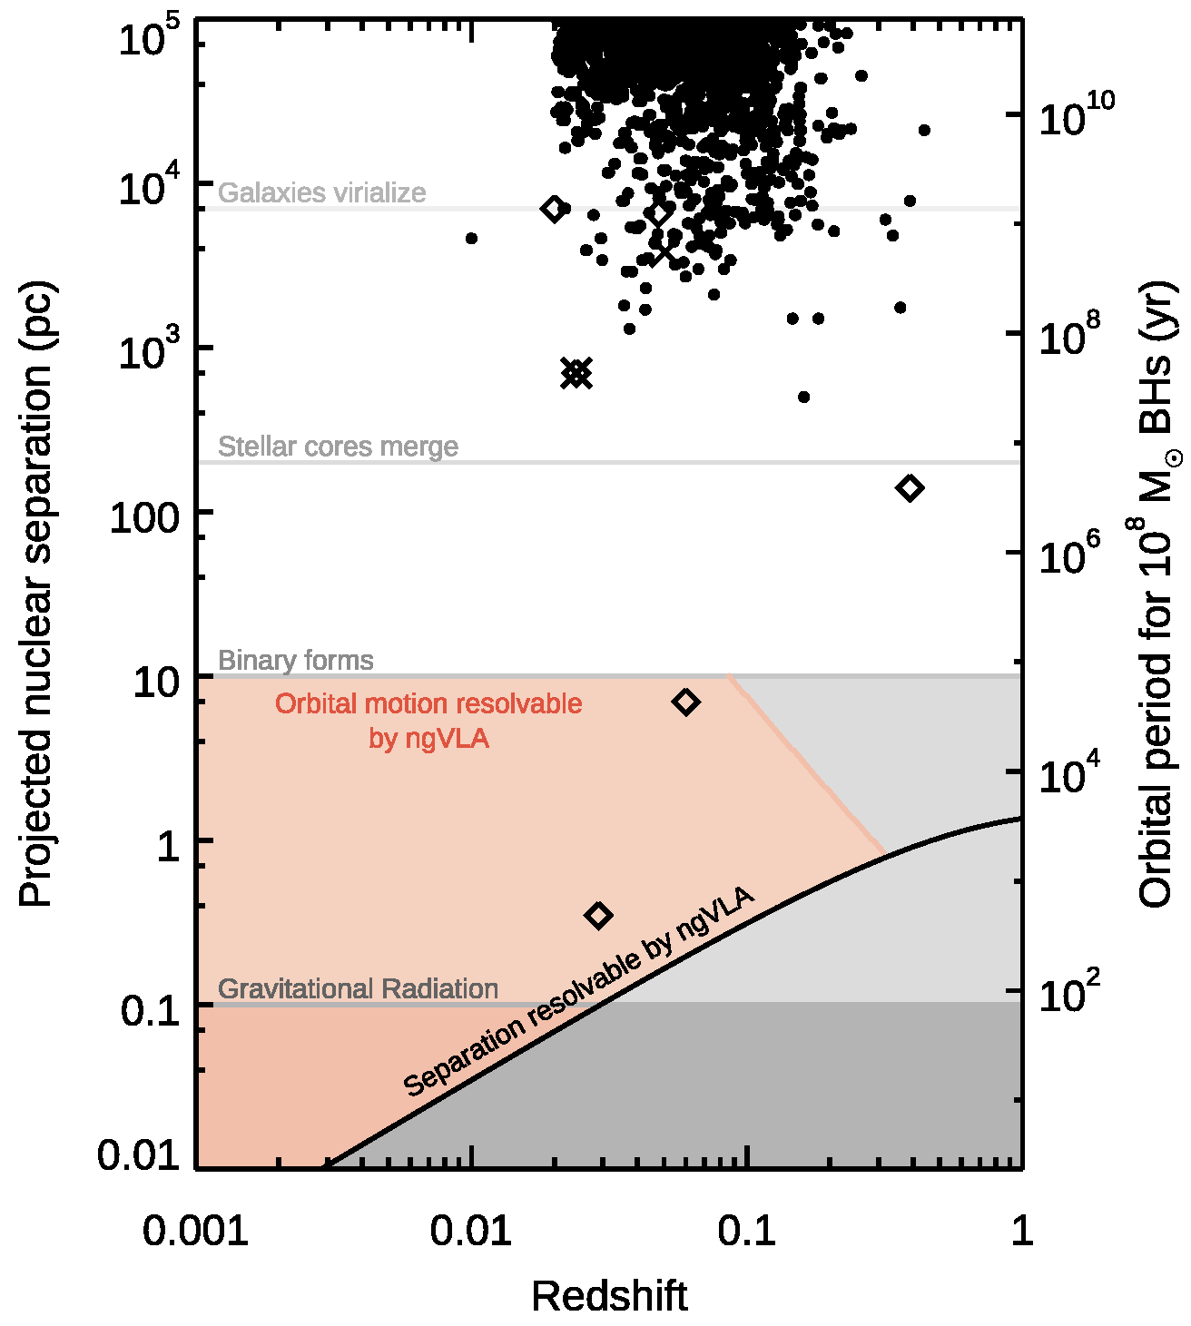
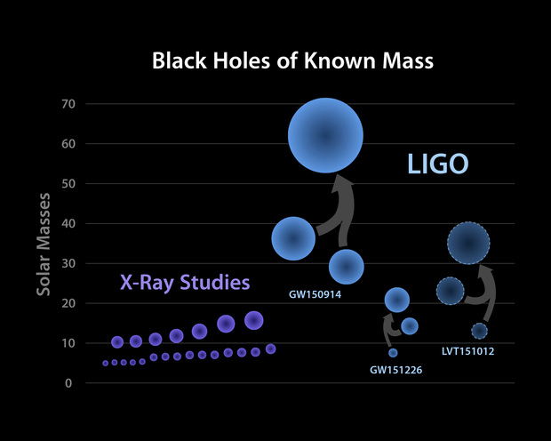
KSG5: Understanding the Formation and Evolution of Black Holes in the Era of Multi-Messenger Astronomy
Unaffected by dust obscuration, the ngVLA’s sensitivity and angular resolution will be able to:
  Resolve dual AGN and BH binaries.
  Measure proper motions over 5 year periods (orange shaded region), including sources detect by GWs
  Search for BHs across all masses, including weakly accreting BHs in the MW via proper motions
Notes:
Dual AGN and black hole binaries, with optical/NIRselected sources as dots, X-ray selected sources as X’s,and radio selected sources as diamonds. The region above the solid black line would be resolvable by the ngVLA, while the region shaded in orange would have measurable proper motions over 5 years if detected at signal-to-noise of 100 (which for Eddington-limited AGN should be achievable in minutes with the ngVLA), at 40 GHz, for 108 solar mass black holes

Slide 21
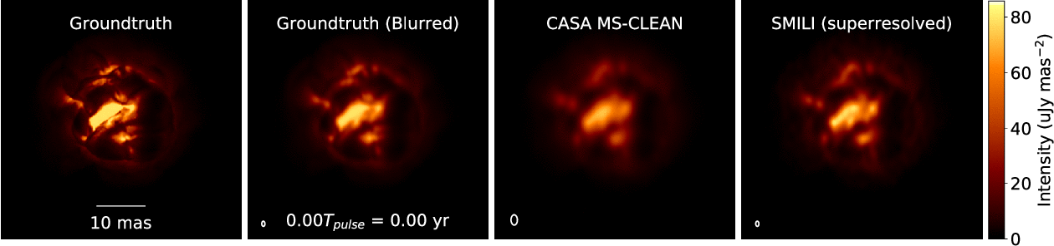
Science Highlight: Star Formation and Stellar Evolution
The ngVLA will measure the in –situ gas motions from material shed around AGB stars.
Simulation based on 3D hydrodynamic model of AGB star Atmosphere from Freytag et al. (2017):
  ngVLA Main Array at 46 GHz
  1.5 mas ~ 0.04 stellar radii at d=150pc
  1.3 year pulse period
  Observed every 2-3 weeks
ngVLA Memo #66
Credit: K. Akiyama & L. Matthews
based on models from B. Freytag
Supported by ngVLA Comm Study Program
Notes:
Simulated movies of the gas motions in the radio photosphere of an asymptotic
giant branch (AGB) star as observed with the ngVLA Main Array at 46 GHz. The
angular resolution is ~1.5 mas, corresponding to roughly 0.04 stellar radii.
Each movie covers a single 1.3-year pulsation period for a model AGB star,
assuming observations every 2-3 weeks. The adopted distance was 150 pc.
AGB star atmospheres are highly dynamic owing to a combination of radial
pulsations, shocks, and large-scale convective processes. These stars also shed
large amounts of matter through cool, dense winds. Radio waves are emitted from
a portion of their atmospheres that lie at a radius of roughly twice the
visible photosphere, and just interior to the wind launch region.
The adopted brightness distribution for the radio photosphere model (the
"ground truth model" shown in the left hand frame) was based on a 3D
hydrodynamic model of an AGB star atmosphere from Freytag et al. (2017). The
Freytag et al. model is not specific to millimeter wavelengths, but was adapted
here for illustrative purposes. The second frame shows the ground truth model
blurred with a Gaussian kernel.
The two frames on the right show image reconstructions of the model based
on simulated ngVLA Main Array observations. The integration time was 2
hours per frame and the assumed bandwidth was 10 GHz in dual
polarizations. The second frame from the right shows a multi-scale CLEAN
reconstruction, while the frame on the right shows the result of a
regularized maximum likelihood reconstruction using the SMILI package of
Akiyama et al. (2019). While both methods do well at reproducing many of
the key features of the model, the SMILI version achieves superior angular
resolution.
These results underscore that the exquisite sensitivity and resolution of the
ngVLA will enable studies of the physical properties and kinematics of the
atmospheres of evolved stars in unprecedented detail.
Credit: K. Akiyama and L. D. Matthews, based on models adapted from B.
Freytag.

Slide 22
Requirements Flow-Down
Begins with Science Use Cases (>80)
  Distilled into ~200 unique observations
Prioritization by SAC
  5 KSGs born out of various use cases
Converted into Level 0 Science Reqs.
  37 Requirements to support KSGs
    18 Functional Reqs.
    19 Performance Reqs.
Translated into Level 1 Technical Reqs.
  180+ System Level Reqs.
Next Step: Full Level 2 Technical Reqs.

Slide 23

ngVLA Reference Design
ngVLA Technical Baseline
1.2 - 116 GHz Frequency Coverage
Main Array: 214 x 18m offset Gregorian Antennas.
  Fixed antenna locations across NM, TX, AZ, MX.
Short Baseline Array: 19 x 6m offset Greg. Ant.
  Use 4 x 18m in TP mode to fill in (u, v) hole.
Long Baseline Array: 30 x 18m antennas located across continent for baselines up to 8860km.
Band # | Dewar | f_{L} GHz | f_{M} GHz | f_{H} GHz | f_{H}: f_{L} | BW GHz
1 | A | 1.2 | 2.35 | 3.5 | 2.91 | 2.3
2 | B | 3.5 | 7.90 | 12.3 | 3.51 | 8.8
3 | B | 12.3 | 16.4 | 20.5 | 1.67 | 8.2
4 | B | 20.5 | 27.3 | 34.0 | 1.66 | 13.5
5 | B | 30.5 | 40.5 | 50.5 | 1.66 | 20.0
6 | B | 70.0 | 93.0 | 116 | 1.66 | 46.0
Notes:
Array components
Front-end 6-bands in two dewars
Up to 20 GHz instantaneous processed bandwidth
Continuum Sensitivity: ~0.1 uJy/bm @ 1cm, 10mas, 10hr => T_{B} ~ 1.8 K
Line sensitivity: ~20 uJy/bm @ 1cm, 10 km/s, 1”, 10hr => T_{B} ~ 25 mK

Slide 24
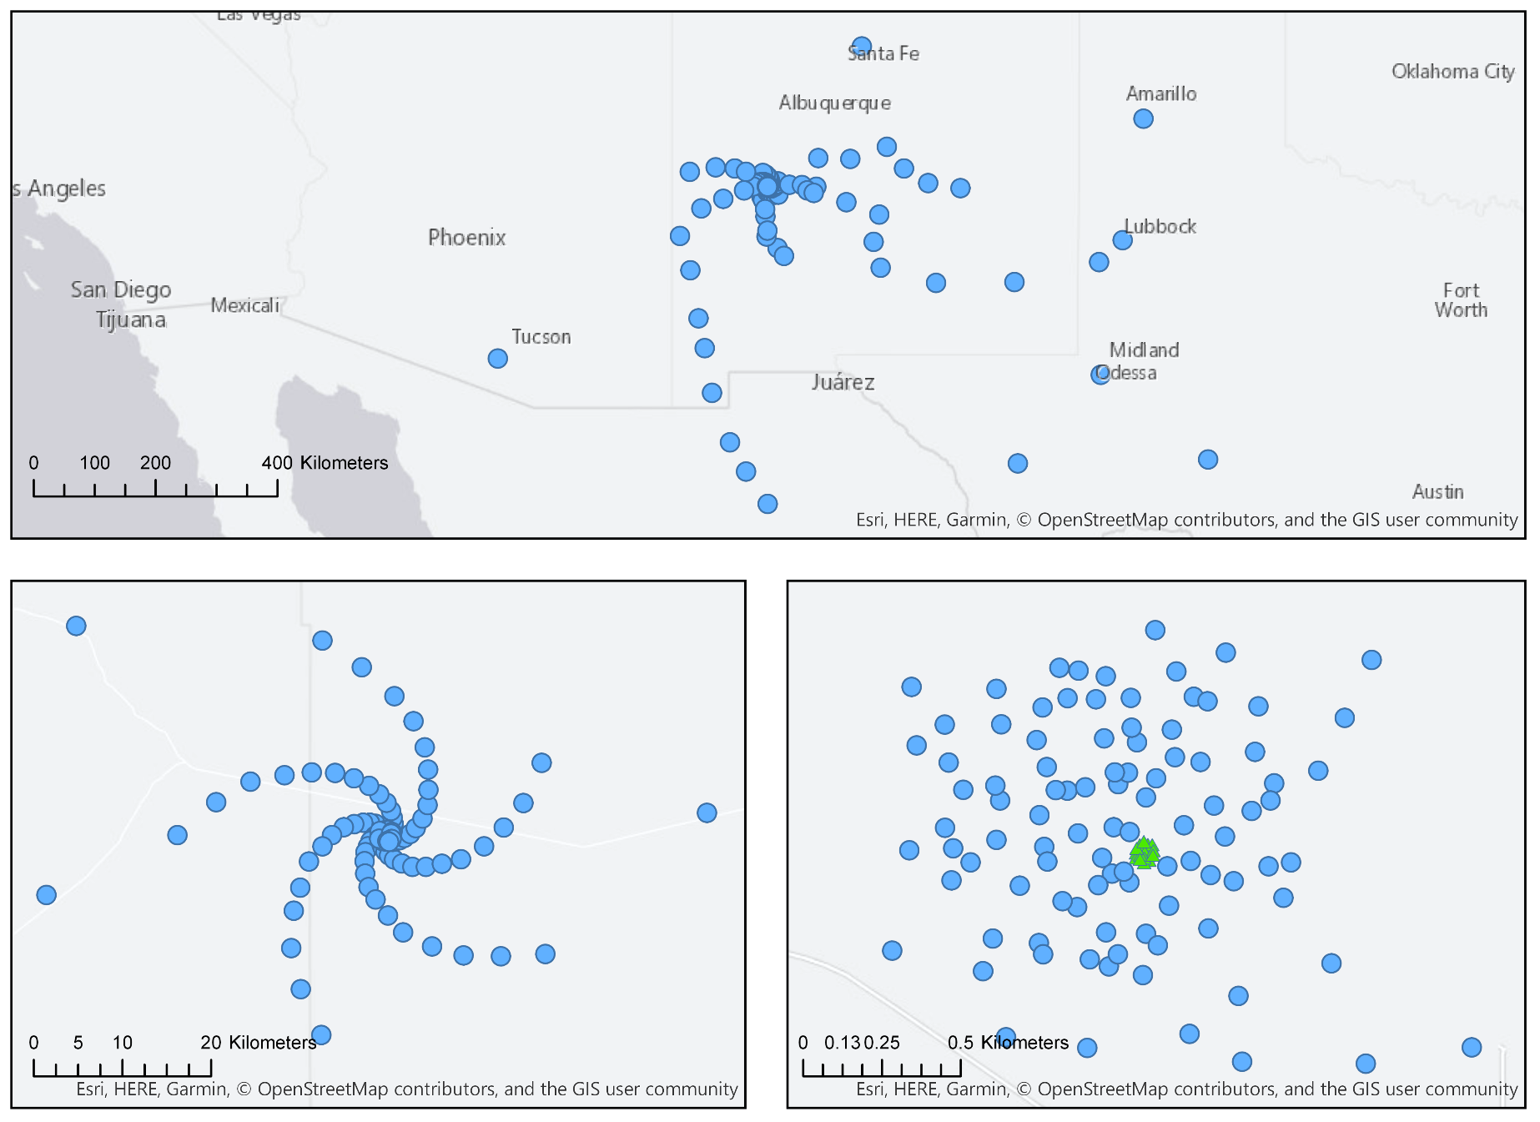
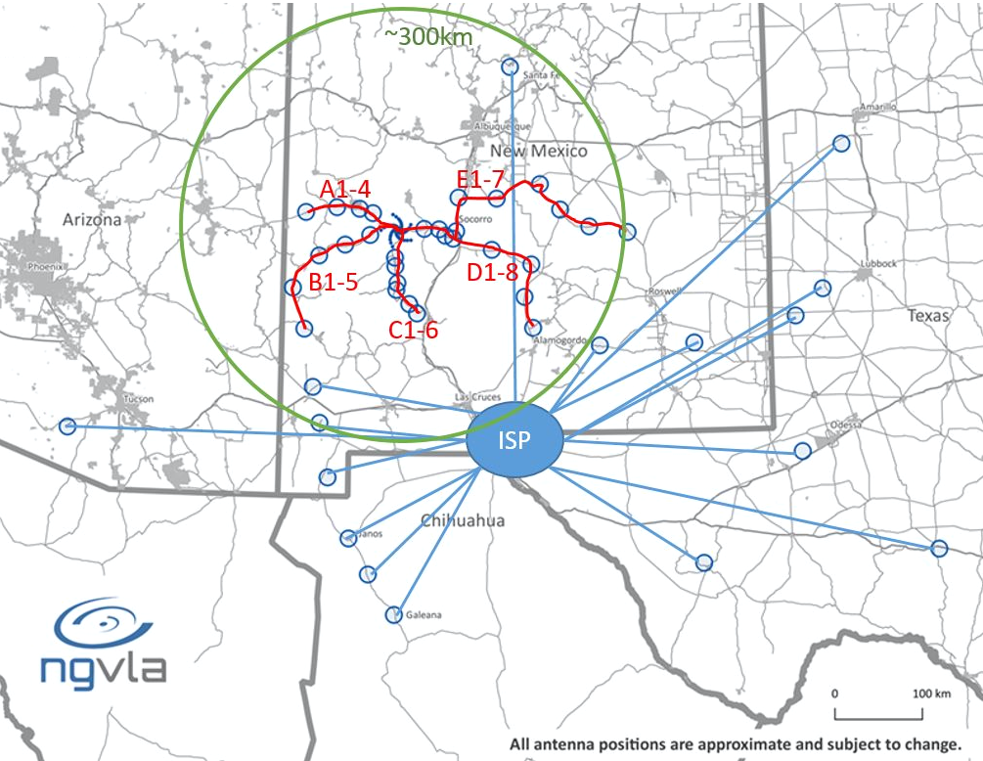
The Main Array (MA) Configuration
Radius | Collecting Area Fraction
0 km < R < 1.3 km | 44%
1.3 km < R < 36 km | 35%
36 km < R < 1000 km | 21%
350 miles
Notes:
Fixed positions
> array quant bmin bmax
> core 94 30 1338
> plains 74 275 36712
core+plains 168 30 36712
> main 214(46) 30 1005363
Challenge of tri-scale-array: Sensitivity vs. resolution
Short baselines: 19 x 6m array + 4 x 18m total power
Options:
5 – 10 dish array in Green Bank

Slide 25
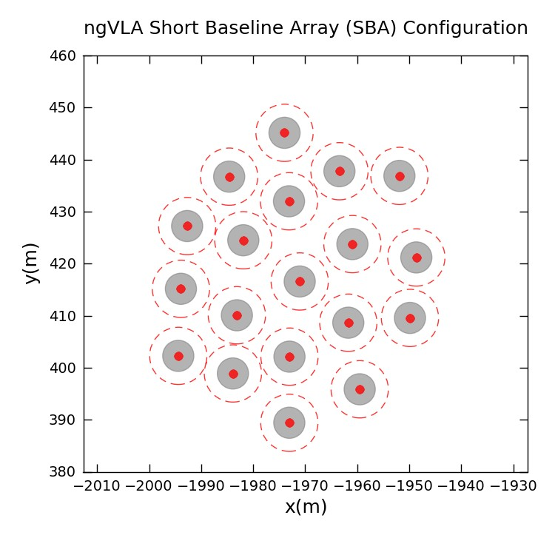
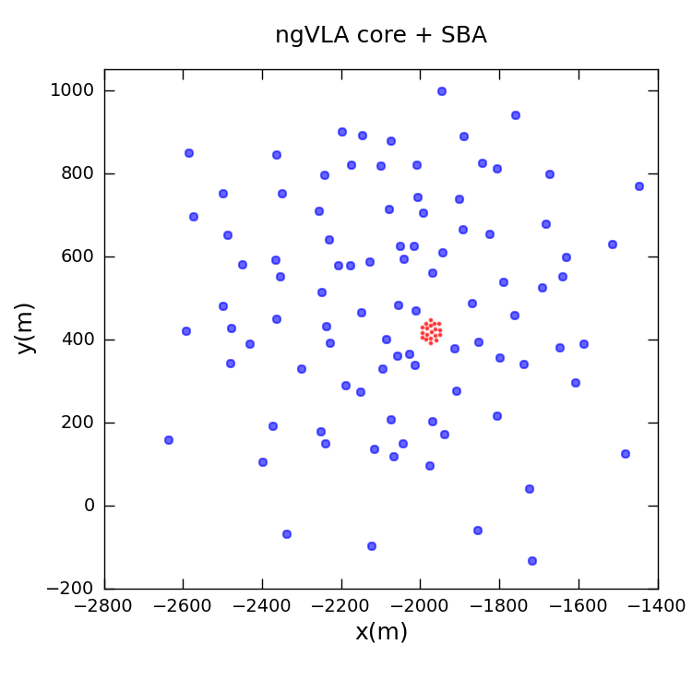
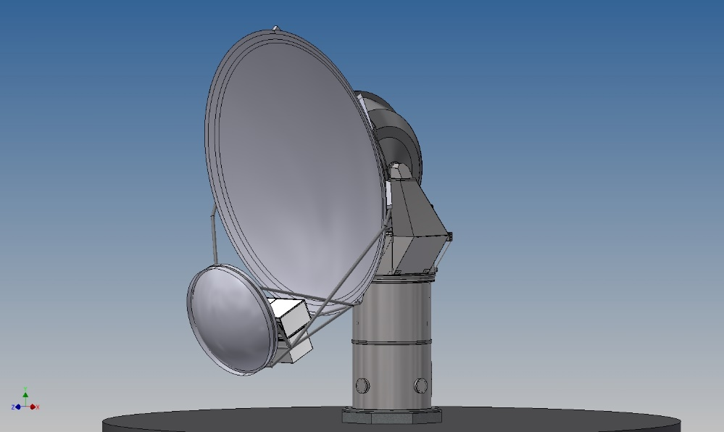
Short Baseline Array (SBA)
SBA of 19 x 6m
Total Power Array of 4 x 18m (included as part of the 214 main array).
Notes:
shortest baseline = 11 m? TBD, 15m current design
KSG3 – Galactic Evolution case needs large scale structure.

Slide 26
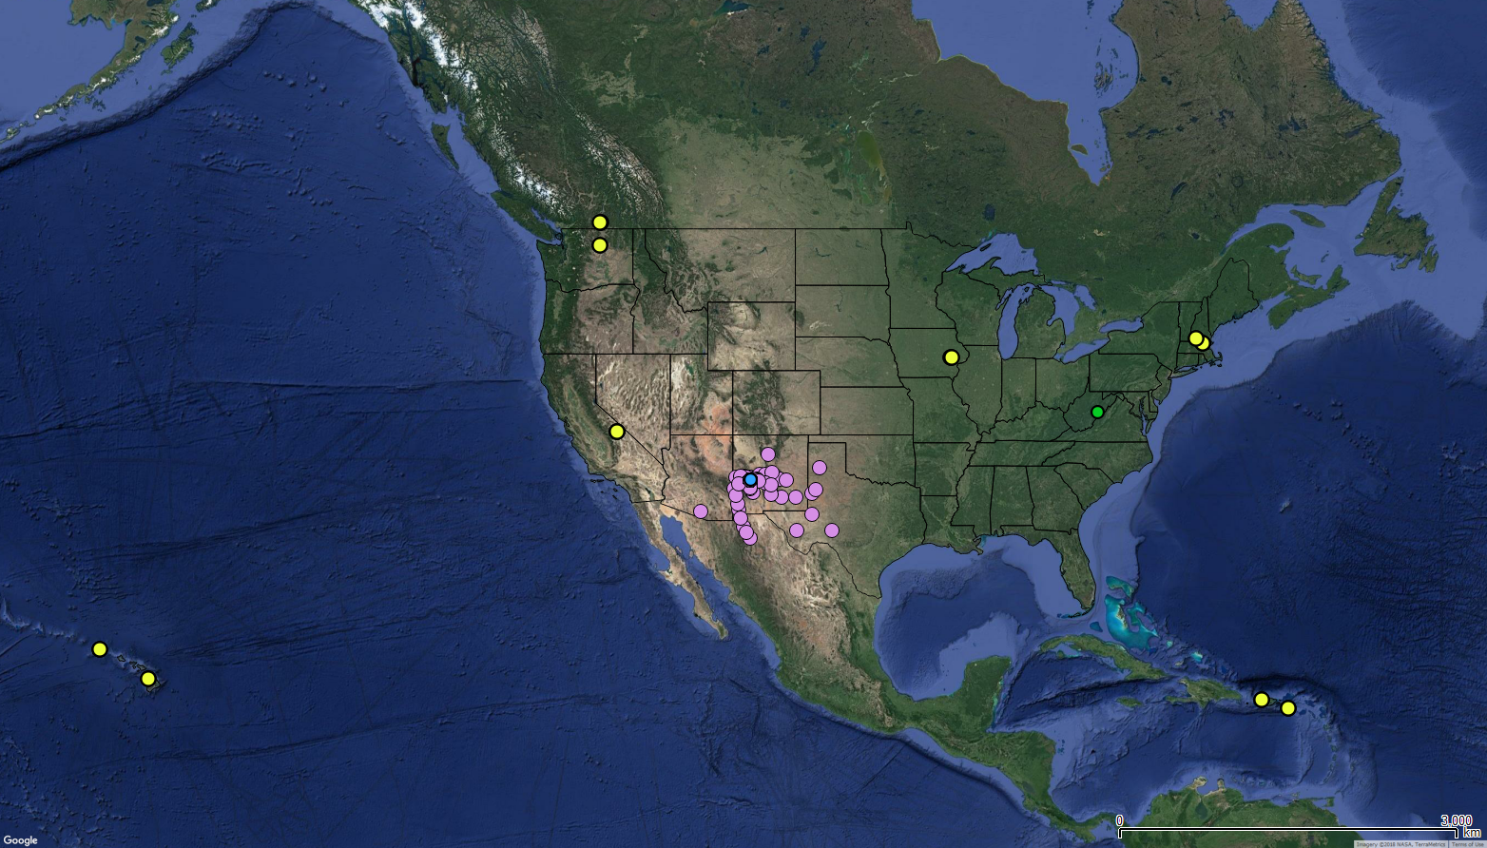
Long Baseline Array (LBA)
30 Antennas at 10 sites.
Balance between Astrometry & Imaging Use Cases.
Qty | Location | Notes
3 | Puerto Rico | Arecibo Site
3 | St. Croix | Existing VLBA Site
3 | Kauai, Hawaii | Kokee Park Geo. Obs.
3 | Hawaii, Hawaii | Not MK Site
2 | Hancock, NH | Existing VLBA Site
3 | Green Bank, WV | GBO
2 | Brewster, WA | Existing VLBA Site
3 | Penticton, BC | DRAO
4 | North Liberty, IA | Existing VLBA site.
4 | Owens Valley, CA | Existing VLBA site.
Notes:
Really Damn Exciting!
Will be able to detect and measure the expansion of GW170817 at AdvLIGO detection horizon of 200Mpc

Slide 27
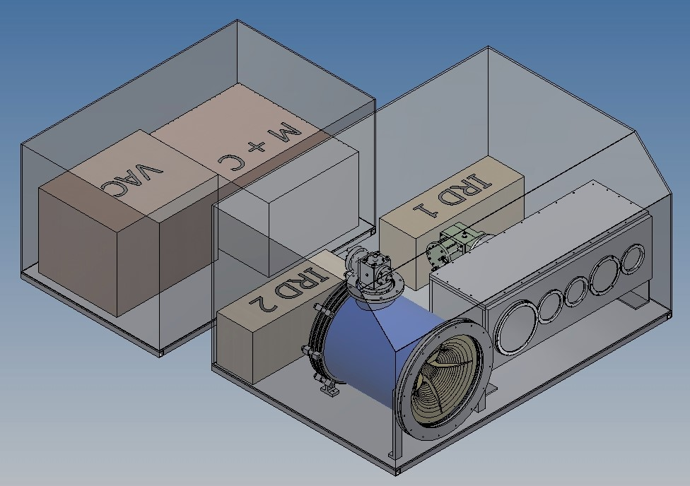
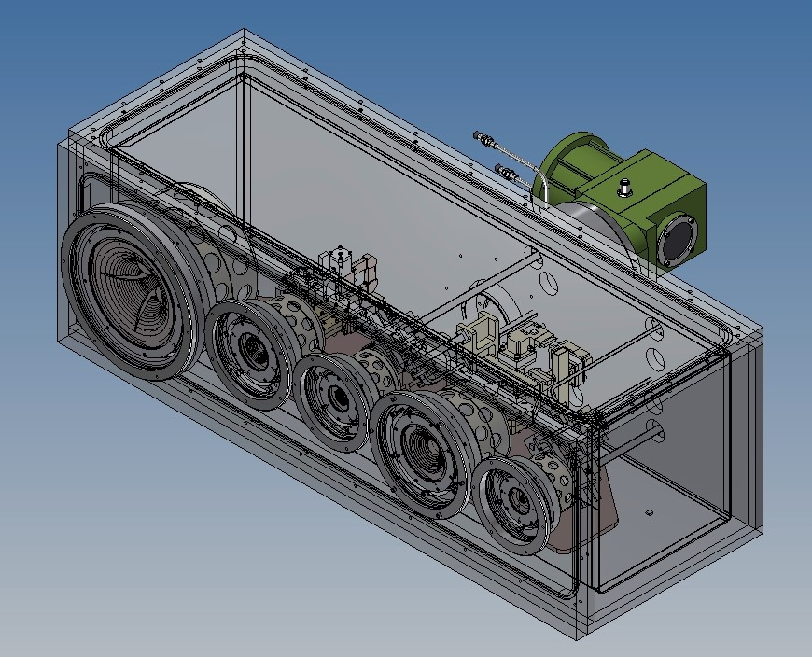
Front End Concept
6 Bands in 2 Cryogenic Dewars
1.2-3.5 GHz and 3.5-12.3 GHz Quad-Ridge Horns, 3.25:1 bandwidth, coaxial LNAs.
12.3-50.5 GHz using three 1.67:1 BW corrugated horns and waveguide LNAs.
70-116 GHz 1.67:1 BW corrugated horn and waveguide LNAs with block down conversion.
Single stage down-conversion to baseband for 5 bands. Direct SSB or IQ sampling using modular devices @ FE.
Two-stage Gifford-McMahon cryogenic system with variable-speed cryocoolers and compressors for reference design.

Slide 28
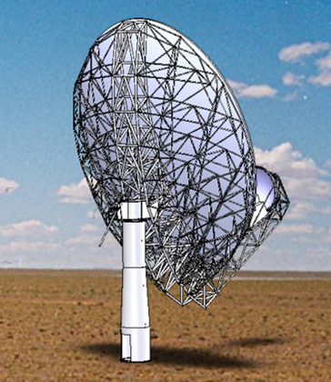
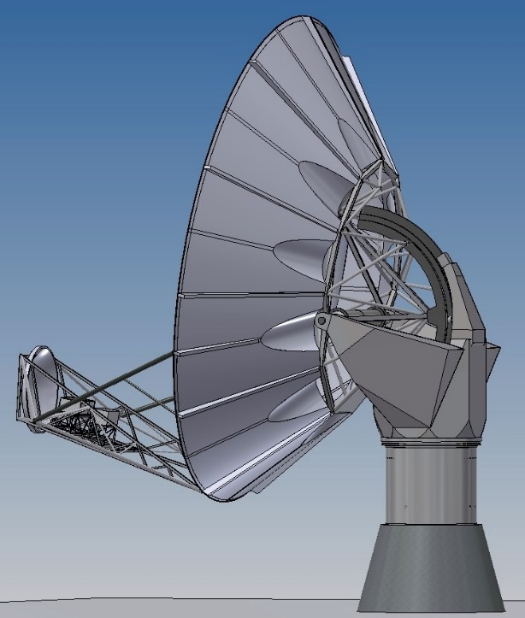
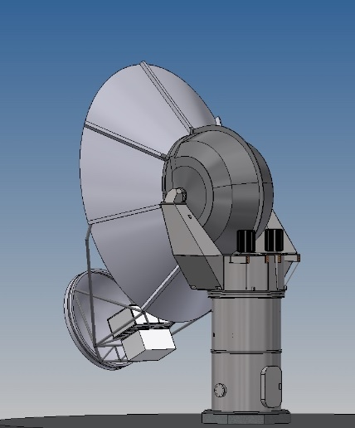

Antenna Concept
GDMS 18m
NRC 18m
Feed Low: Maintenance requirements favor a receiver feed arm on the low side of the reflector.
Mount concept: Leaning towards pedestal concepts for life-cycle cost. W/T under evaluation.
Drives: All motor-gearbox; gearbox and linear drives; all direct drive, etc.
Materials: Traditional Al panels & steel BUS; composite reflector and mix of steel and carbon BUS.
NRC 6m
Key Specifications
18m Aperture | Offset Gregorian
Shaped Optics | 4° Slew & Settle in 10 sec
Surface: 160 µm rms | Referenced Pointing: 3” rms
Notes:
Emphasize CA and GDMS/Vertex Design
Exploring other designs next year before selecting a concept to proceed to prototype.

Slide 29
S/W and Computing Considerations
Operations Concept: SRDP (Science Ready Data Products) Telescope
  Both for 1st Observations and Archive projects.
Post Processing: Analysis shows that storing the raw visibilities will be tractable when ngVLA goes into operations.
  Data processing is post-facto, with system sized for average throughput.
  Average Data Rate – 7.6 GB/s. Designed for 320 GB/s peak.
  4 hr. observation – 109 TB. Requires ~1000 cores to process in a few days.
Computing: 2B Core-hr: Challenging, but can be met w/ COTS cluster.
  Set by time resolution, spectral resolution, and multi-faceting in imaging
  Some low-frequency, full-beam, AW-projection cases restricted in early operations.
Notes:
Max rate: 320 Gbps FE -> CSP
7 TeraVis/hour = 7.6 GB/s (Average) -> 109 TB in 4 hr
120 TeraVis/hour = 130 GB/s (peak) -> 1.9 PB in 4 hr
1500 standard (without W/A-projection)
Can grow up by ~x1000
** 60 PFLOPs/s --- size of the system (factors efficiencies – size of Frontera UT super computer 40 PFLOPs)
We are big… Moore’s law has flattened… so improvement from different areas.
For Spectra: Parallelization very efficient (Embarrassingly parallel l!!)
Most cases, require lots of channels (>100k) -- each channel can be processed independently.
Challenge is just processing a lot data, to achievable.
External Processing centers (e.g., OpenScienceGrid)
Accommodate projects whoe throughput beyond our capabilities
E.g., 1 big survey project exceeds 60 PFLOP/s, exceeds latency needed for data delivery
OpenScienceGrid (High Throughput Computing) – golfballs in container vs. basketballs – increase granularity to accommodate flexibility.
Group of universities to join computing with common software (i.e., different than EXCEED)
Part of LHC – largest computing problem in public sector (1B core-hour core problem… ngVLA will be 2B)
HTC framework dividing jobs into small junks sent to different facilties.

Slide 30
jmw
Anticipated Usage
Built a Reference Observing Program (ROP) for a 70% “learning” year
  Driving use cases only
  Filled ~ 2000 hours
  For Astro2020
  Demonstrates we can achieve KSGs
Build an Envelope Observing Program (EOP) for a 95% “typical” year
  All use cases
  Fill 8330 hours
  To inform Computing needs and Ops Concept

Slide 31
Current Goals & Initiatives
Current goals:
  Be ready to react to a positive Astro2020 Decadal Survey outcome.
    Currently expected this month (June 2021)
  Advance the ngVLA Conceptual Design for NSF MREFC Candidacy
Current initiatives:
  Continue to build and hone the ngVLA science case
    Driven by the community and coordinated by NRAO
    Update/incorporate additional science cases to ngVLA Science Book
  Develop ngVLA Conceptual Design and Requirements Baseline
    Finalize antenna design and prototype
    Work towards a finalized Conceptual Design to be external reviewed in Q1 FY22

Slide 32
Status & Performance
ngVLA now funded through its own Cooperative Support Agreement with NSF
Continue strong community engagement and participation through ngVLA SAC and sponsored events
Updating requirements and retiring existing risks through management and systems engineering
Awaiting NSF/MSIP award to fund prototype antenna.
Continuing to identify and develop Broader Impact/Participation Opportunities with IPTs vis a strategic communication plan.

Slide 33
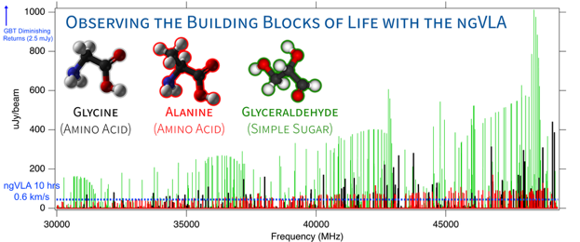
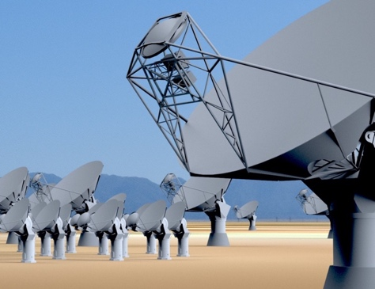
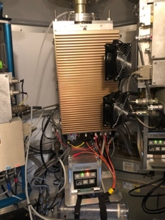

FY20 Activities
Respond/Present to Astro2020 Program Panel RFIs
  Presented to RMS Panel (Feb. 2020) + Response to 2nd RFI (Mar. 2020)
Submit MSIP proposal for antenna detailed design and prototype
  Validated antenna used to support ongoing university-based intensity mapping experiment (i.e., Caltech/COMAP-EoR)
Conduct System Requirements external review
Support ngVLA technical meetings
  SPIE Astronomical Telescopes & Instrumentation, San Diego (Dec 13-18)
  NARSM 2020, Montreal (July 5-10 – Virtual)
Support ngVLA science meetings
  Compact Objects in the Multi-Messenger Era,
    Virtual (July 14 – 15, 2020) + Saint Paul MN (Jun 23 – 25, 2021)
Test 5 WVRs on VLA Antennas w/ new Tipping Radiometer
Continue to Develop ngVLA Broader Impact/Participation Plan

Slide 34
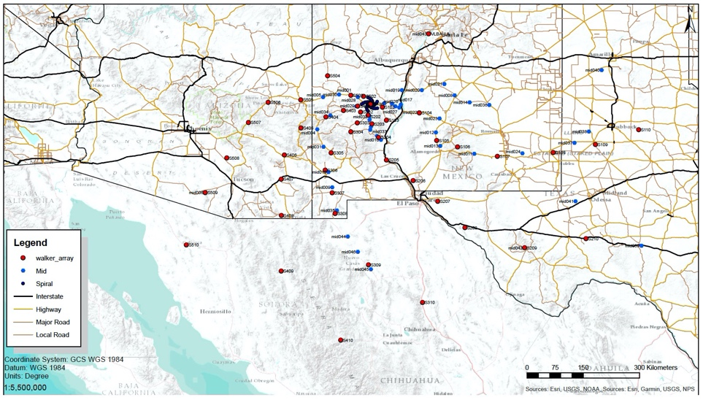


FY21 Activities
Hosted Special Session at AAS
Supporting ngVLA Community Studies
  7 approved and 4 funded
Hired new ngVLA Research Associate
Document Prep. for FY22 Conceptual Design Review (Requirements Baselined)
  Substantial update to the configuration and simulation analysis tools
  CSV Test Planning
  Software Requirements Capture
  Observing Mode Calibration Strategy
  …
Awaiting MSIP Funding for Antenna Final Design
and Prototype Kickoff
Ramp up on Preliminary Design on all major systems
Notes:
requirements baselined; all major conceptual decisions made by this point. Ramp up on preliminary design for prototype on all major systems thereafter.

Slide 35






ngVLA Antenna Development
An OHB Company
Notes:
Recently had two antenna concept studies:
1) Costed Concept – Demonstrated that the antenna requirements can be met
2) Final Design and Prototype – Demonstrated that the cost is similar than our original estimates used in the ngVLA reference design submitted to Astro2020.
- Vendor selected to lead the final design and prototype effort
Prototype Funded now by NSF – should be at VLA site in 2023

Slide 36

ngVLA Antenna Development
Contract Awarded to mtex
Antenna contract contains 4 options
  Baseline – Preliminary Design Phase 1
  Option 1 - Preliminary Design Phase 2
  Option 2 - Prototype Development
  Option 3 – Final Design
FY21 antenna budget supports the Baseline option
NSF MSIP funding supports the 3 remaining options
  Does not include Project Office Funding

Slide 37

Broader Initiatives
Supporting Astro2020 Decadal Survey (TRACE)
Building University, Industrial and International Partnerships
Education and Public Outreach Campaign.
Broadening Participation
Fostering Broader Impacts to the Community (e.g. Rural Broadband)

Slide 38
Cost Estimate: Const. & Ops.
Most recent cost estimate for construction:
  $1.9B in 2018 base-year dollar point estimate, $2.25B risk adjusted.
  Seeking ~25% International Partner Contributions (discussions underway), ⇒ <2018$1.4B U.S. Contribution to ngVLA, <$1.7B risk adjusted
Target operations budget of 2018$92.7M/yr (core: 85M/yr + extended: 8M/yr).
  Operations, maintenance, computing, archiving, etc. Optimize as part of design.
  Expect changes to Observatory-wide administration & science operations model.
Notes:
Change in base-year (2016 to 2018) – 5%, 75M
5% estimating error.
Much higher fidelity model – eliminated parametric inputs, more bottom-up engineering basis
Currently ~$6M/yr project. Stay at this scale through 2021.
$75M design effort over 5 years. 8,8,20,20,20

Slide 39










Project Timeline
2019
2021
2023
2025
2028
2034
ngVLA Submission to Astro2020
Prototype Delivered to VLA Site
ngVLA Construction →
Initiate ngVLA Early Science
(> VLA capabilities)
Complete NSF/MREFC FDR
Achieve Full
Science Operations
Submit ngVLA Proposal to NSF/MREFC
Astro2020 Recommendation Published

