Slide 1
A next-generation Very Large Array

Slide 2
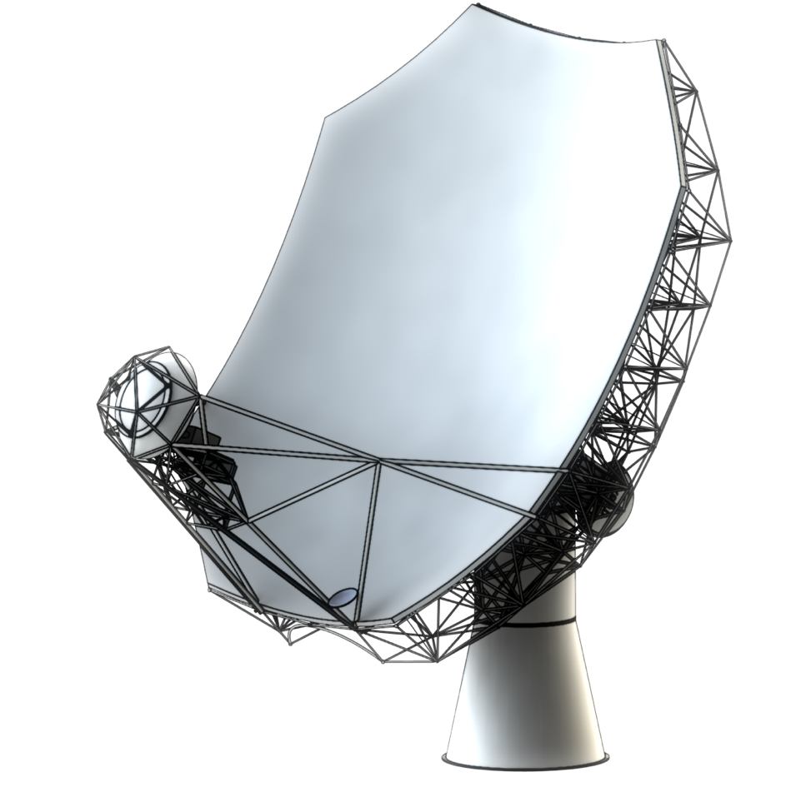
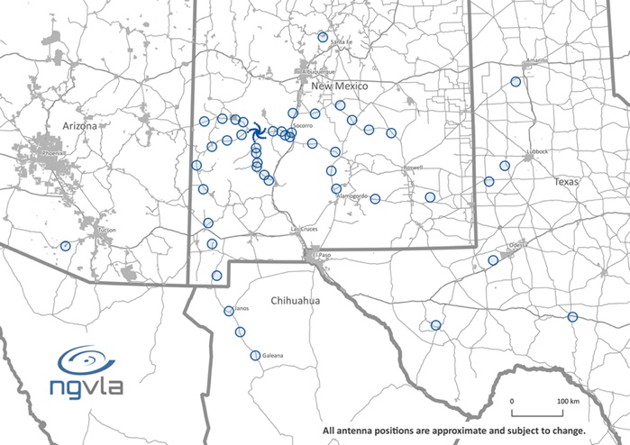
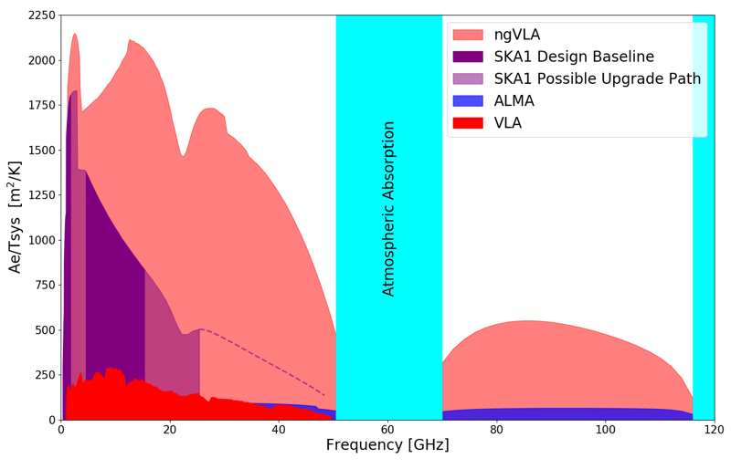
A next-generation
Very Large Array (ngVLA)
Scientific Frontier: Thermal imaging at milli-arcsec resolution
Sensitivity/Resolution Goal: 10x sensitivity & resolution of JVLA/ALMA
Frequency range: 1.2 –116 GHz
Located in Southwest U.S. (NM, TX, AZ) & MX, centered on VLA
Low technical risk (reasonable step beyond state of the art)
550 km
Bridging ALMA/SKA Scientifically
Complementary suite of meter-to-submm arrays for the mid-21st century
< 0.3 cm: ALMA 2030
0.3 to 3 cm: ngVLA
> 3 cm: SKA
http://ngvla.nrao.edu
Notes:
MAIN GOAL OF ARRAY
To be flexible enough to support the breadth of scientific investigations that will be proposed by its creative scientist-users over the decades-long lifetime of the instrument.

Slide 3
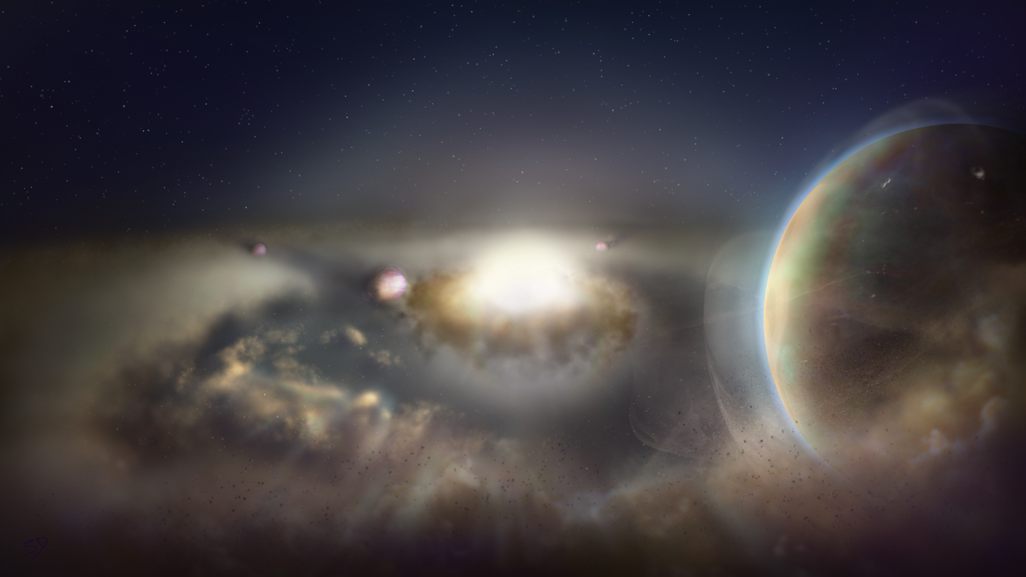
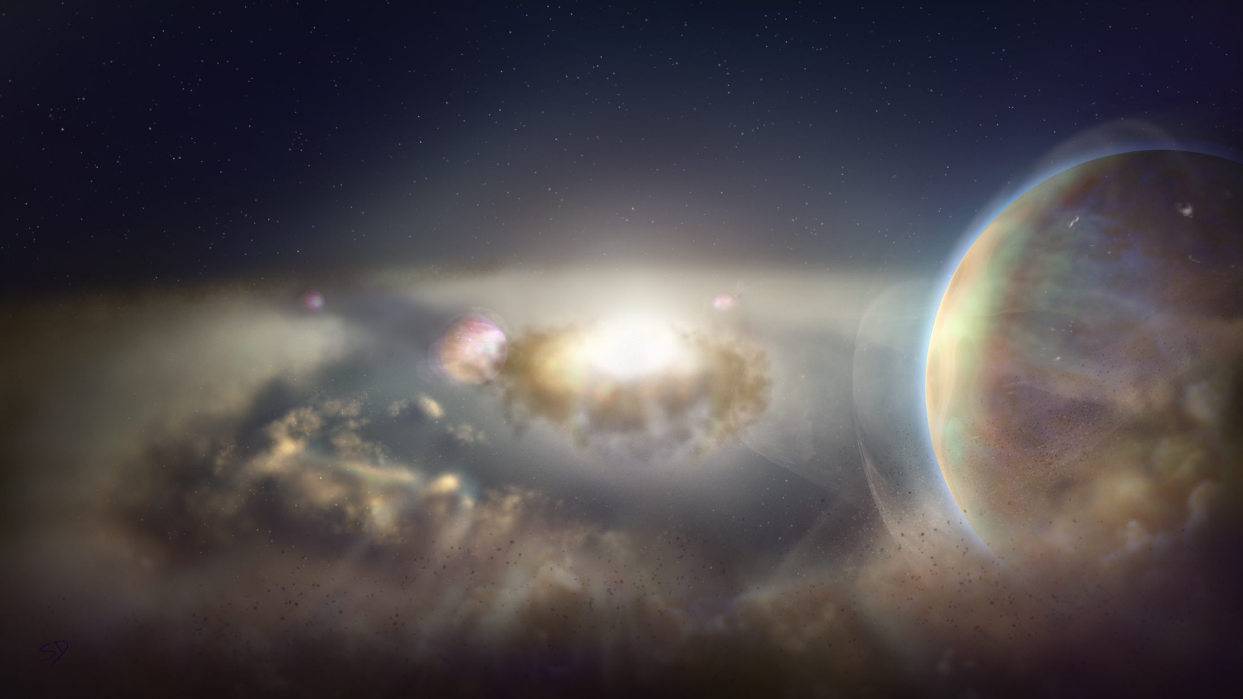
The ngVLA Key Science Goals
Unveiling the Formation of Solar System Analogues on Terrestrial Scales
Probing the Initial Conditions for Planetary Systems and Life with Astrochemistry
Charting the Assembly, Structure, and Evolution of Galaxies Over Cosmic Time
Using Pulsars in the Galactic Center as Fundamental Tests of Gravity
Understanding the Formation and Evolution of Stellar and Supermassive
BH’s in the Era of Multi-Messenger Astronomy
ngvla.nrao.edu

Slide 4
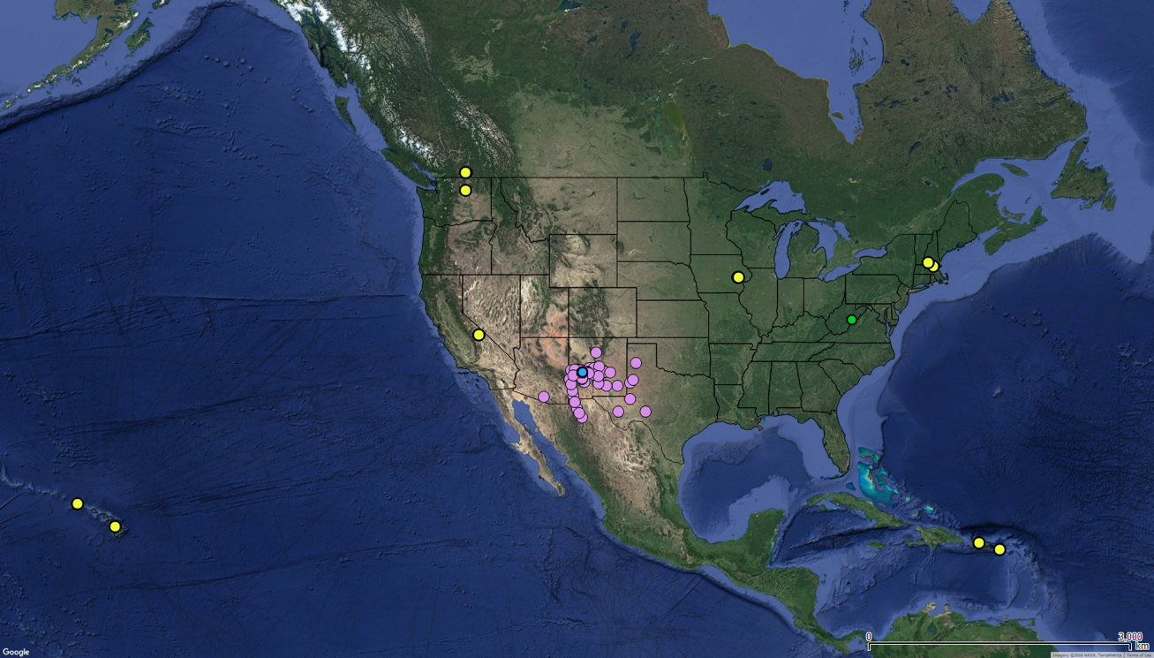
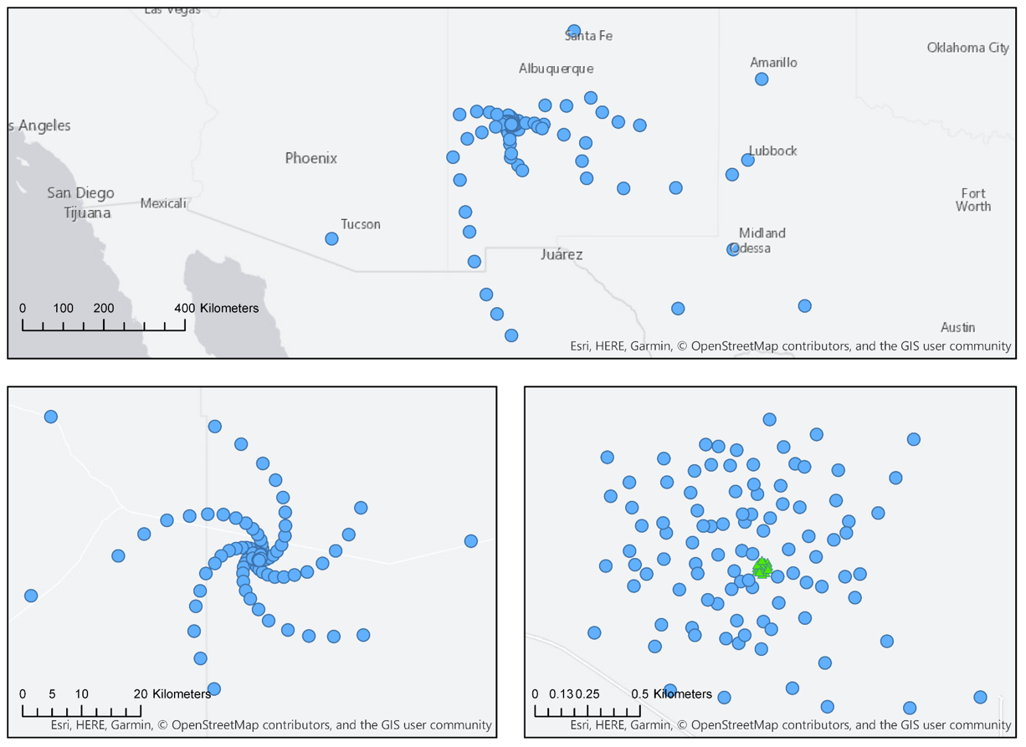
Current
Distribution of Antennas
Radius | Collecting Area Fraction
0 km < R < 1.3 km | 44% (94 antennas)
1.3 km < R < 36 km | 35% (74 antennas)
36 km < R < 1000 km | 21% (46 antennas)
Qty | Location | Notes
3 | Puerto Rico | Arecibo Site
3 | St. Croix | VLBA Site
3 | Kauai, HI | Kokee Park Obs.
3 | Hawaii, HI | Not MK Site
2 | Hancock, NH | VLBA Site
Qty | Location | Notes
3 | Green Bank, WV | GBO
2 | Brewster, WA | VLBA Site
3 | Penticton, BC | DRAO
4 | North Liberty, IA | VLBA site
4 | Owens Valley, CA | VLBA site
350 miles
+30 additional
LBA antennas
Notes:
Fixed positions
> array quant bmin bmax
> core 94 30 1338
> plains 74 275 36712
core+plains 168 30 36712
> main 214(46) 30 1005363
Challenge of tri-scale-array: Sensitivity vs. resolution
Short baselines: 19 x 6m array + 4 x 18m total power
Options:
5 – 10 dish array in Green Bank

Slide 5
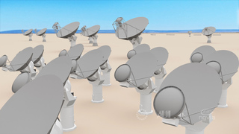
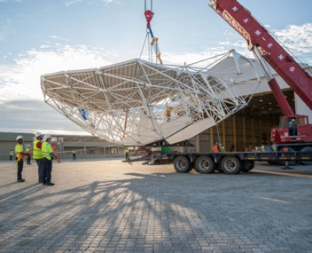
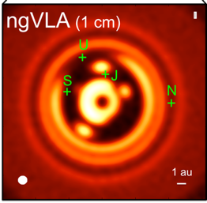
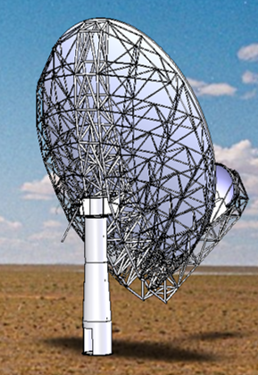



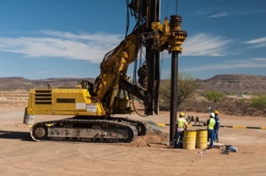
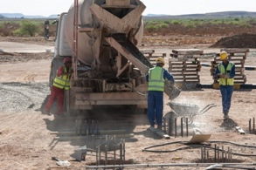
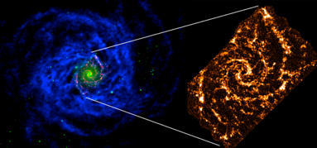
Project Timeline
2019
2021
2023
2025
2028
2034
ngVLA Submission to Astro2020
Prototype Delivered to VLA Site
ngVLA Construction →
Initiate ngVLA Early Science
(> VLA capabilities)
Complete NSF/MREFC FDR
Achieve Full
Science Operations
Submit ngVLA Proposal to NSF/MREFC
Astro2020 Recommendation Published

